Slide 1
Community engagement for social & environmental justice
Tyson Domer & Sarah Wiehe
October 23, 2011

Slide 2
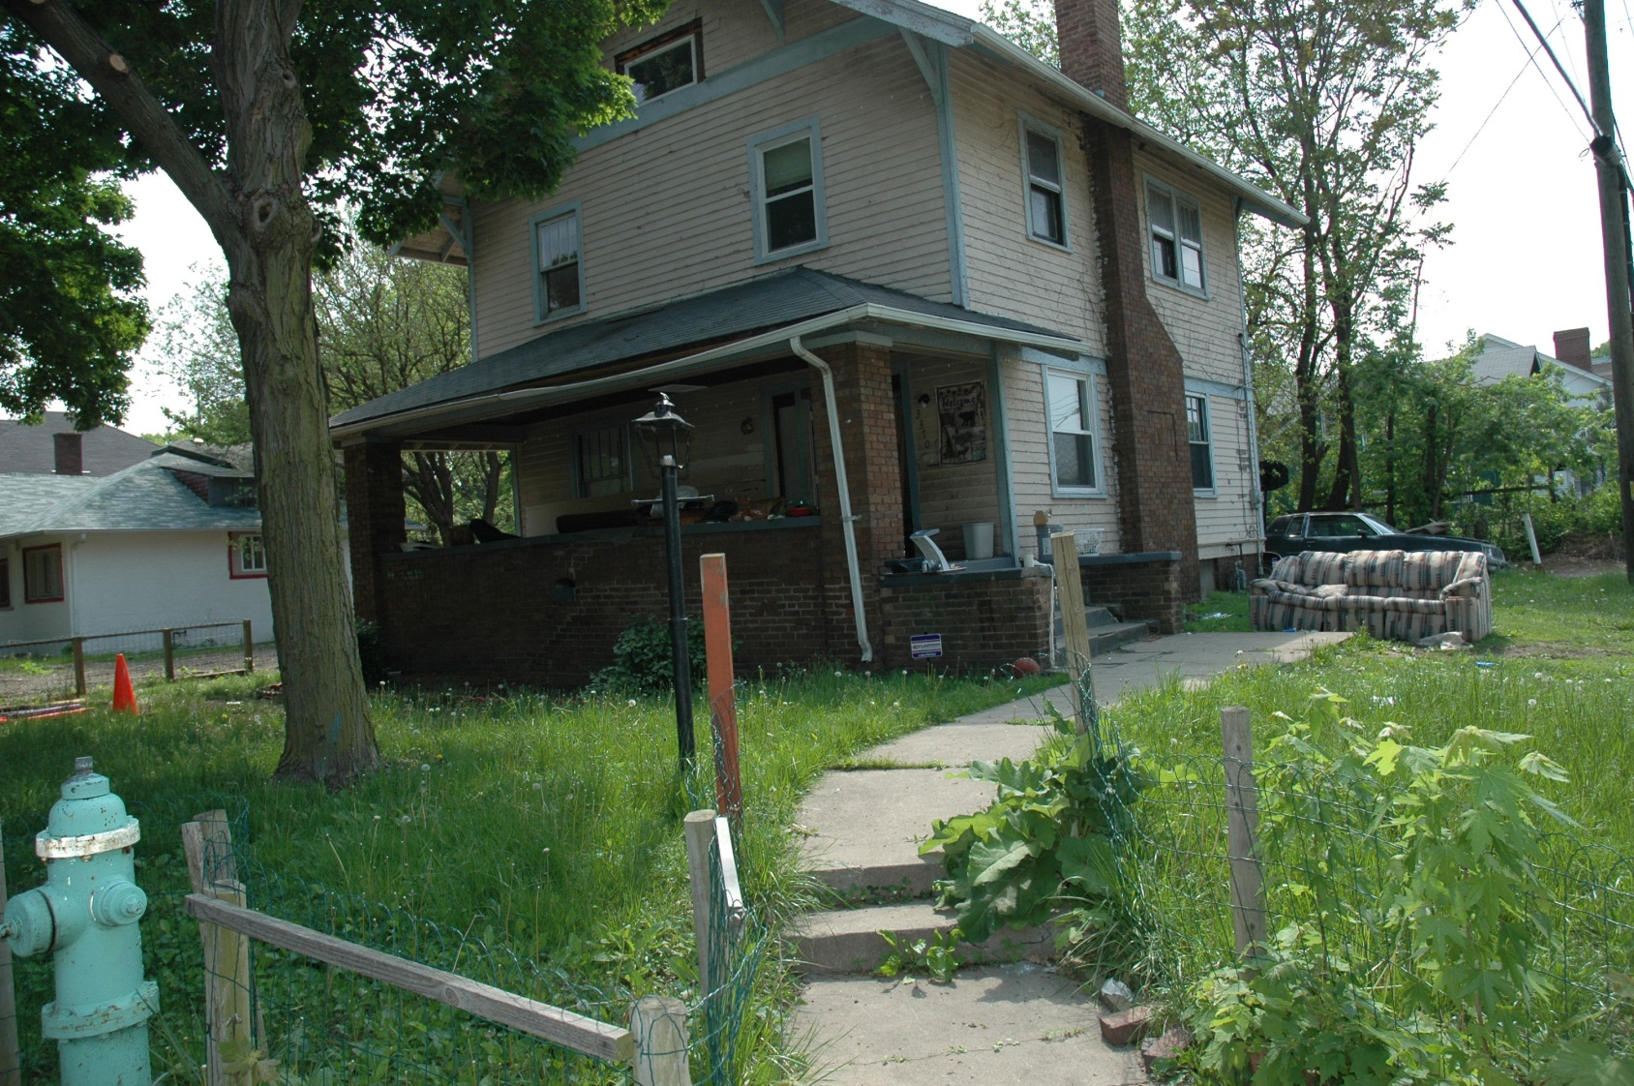
Our story…

Slide 3
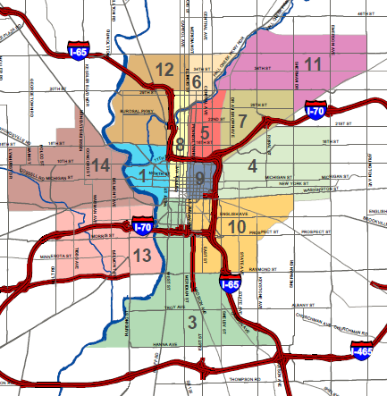
Community Development Corporations aka “CDCs”
non-profits
community organizing
development
housing, commercial
supportive services
place making
leverage resources & capital

Slide 4
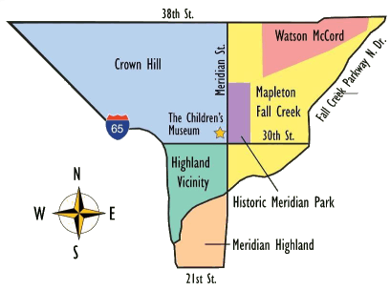
Comprehensive Community Development Asset-Based Community Development
bottom-up approach
vs. top-down…
Quality of Life focus
Great Indy Neighborhoods
Near Eastside
Super Bowl Legacy Projects
Mid-North QOLP
www.midnorthplan.org
www.abcdinstitute.org

Slide 5
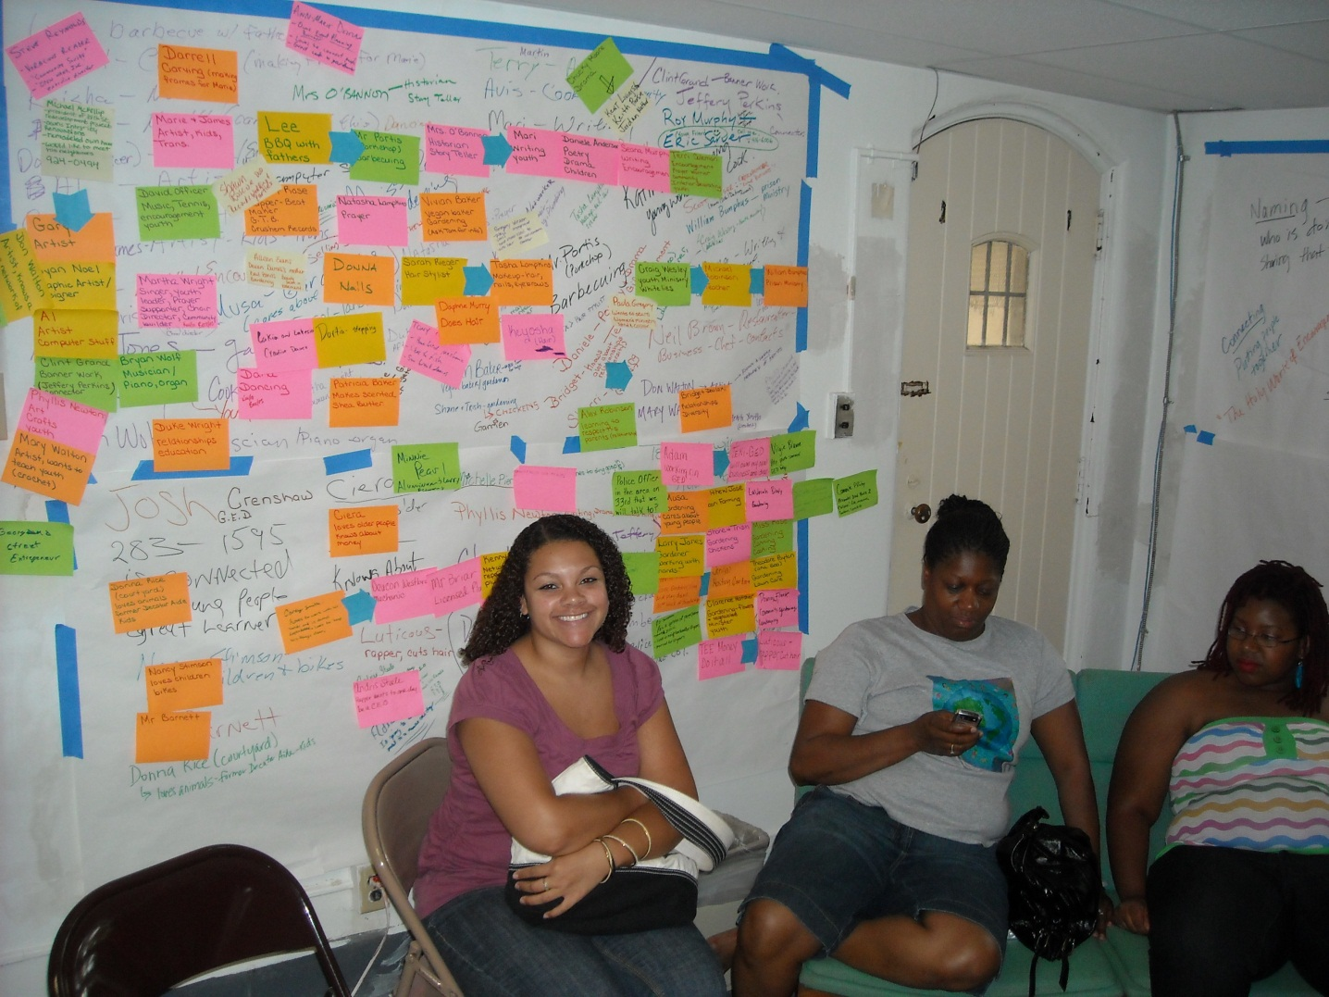
Asset-Based Community Development Quality of Life Planning
visioning
what do you want to see?
action teams
housing, education, safety, etc.
partners
implementation capacity
goals
4 month, 1-year, 3-year

Slide 6
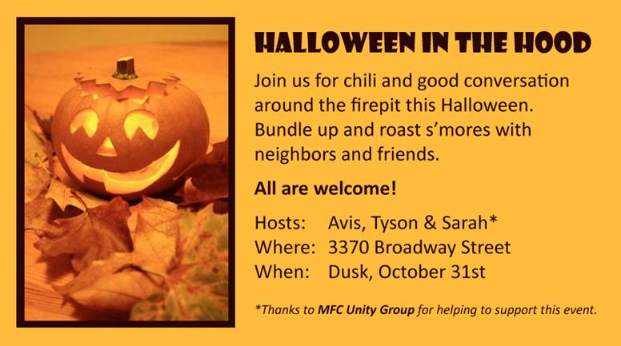
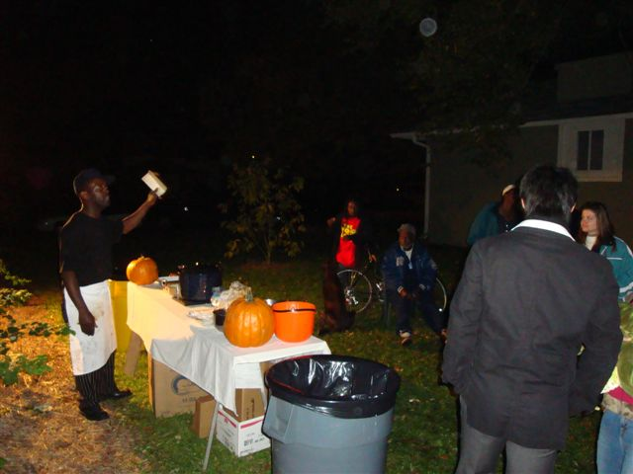
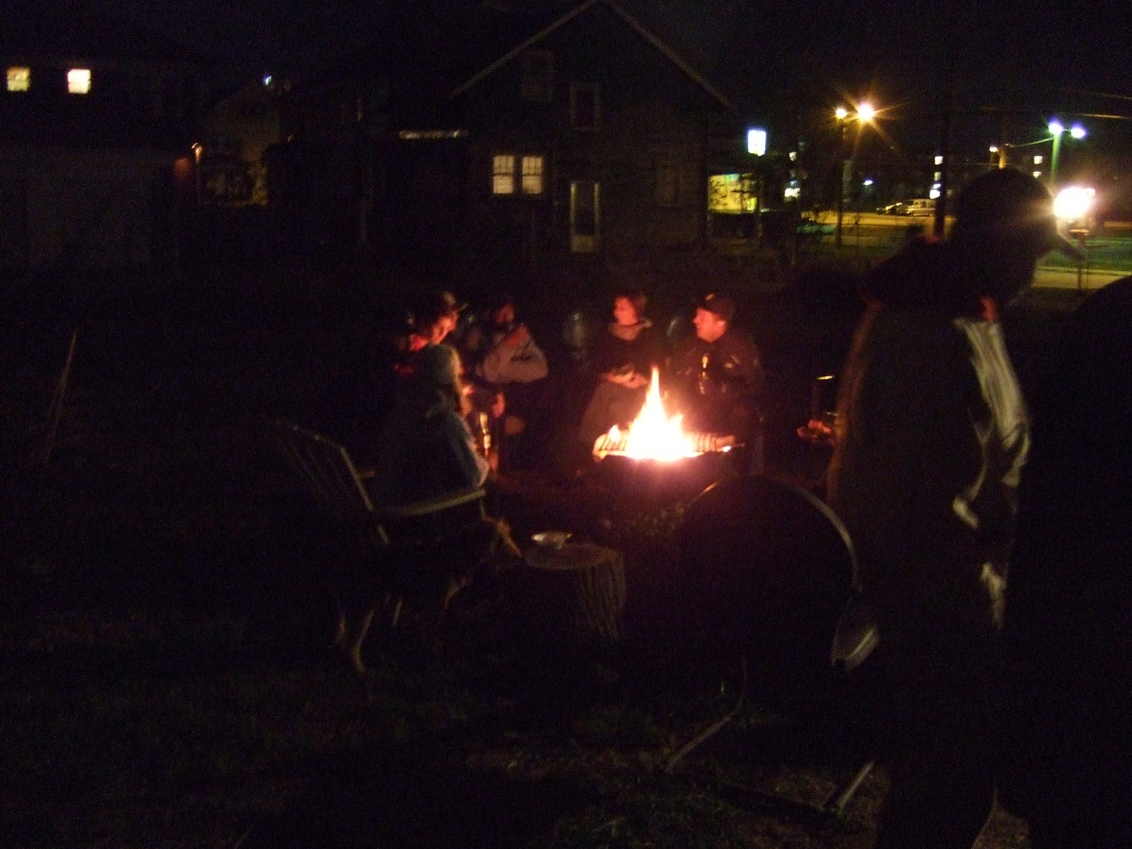
Community Engagement Halloween in the ‘Hood
2010
2008

Slide 7
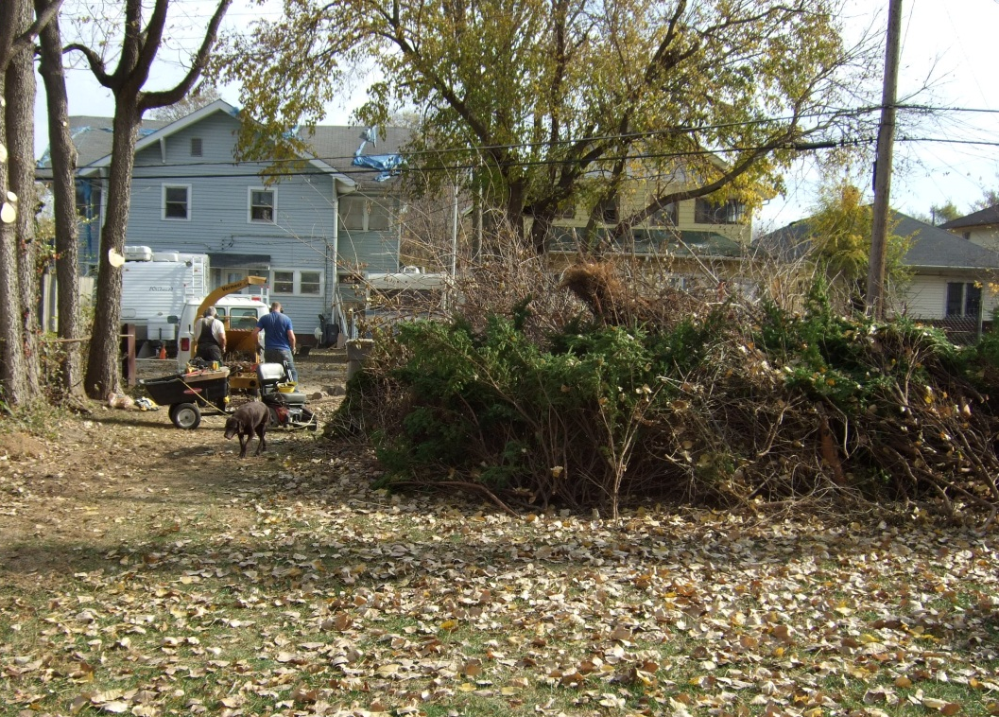
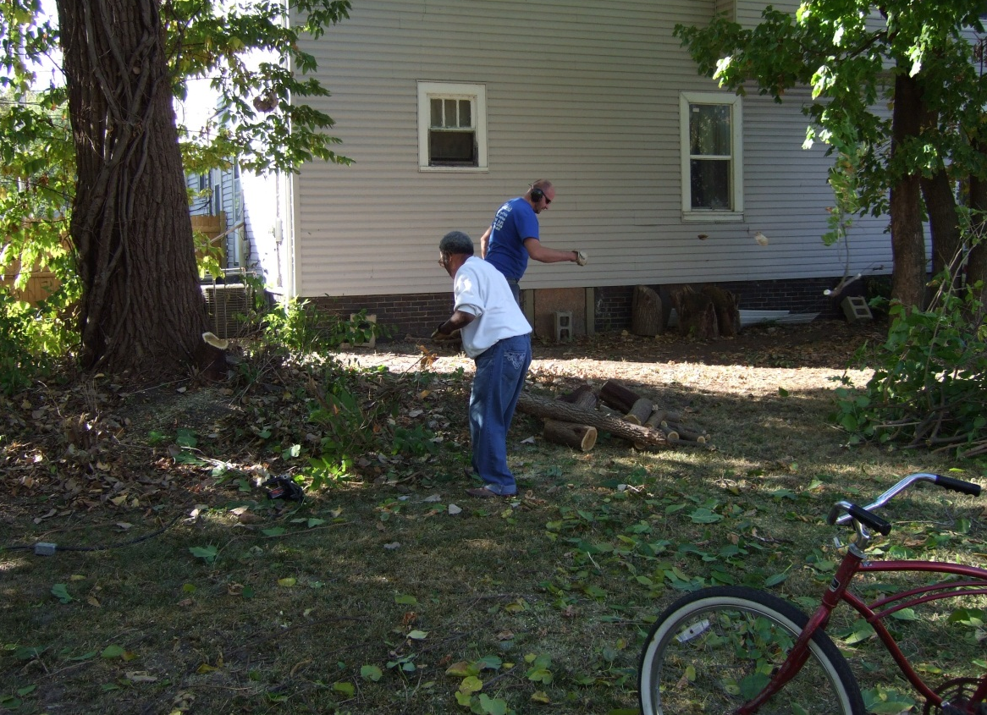
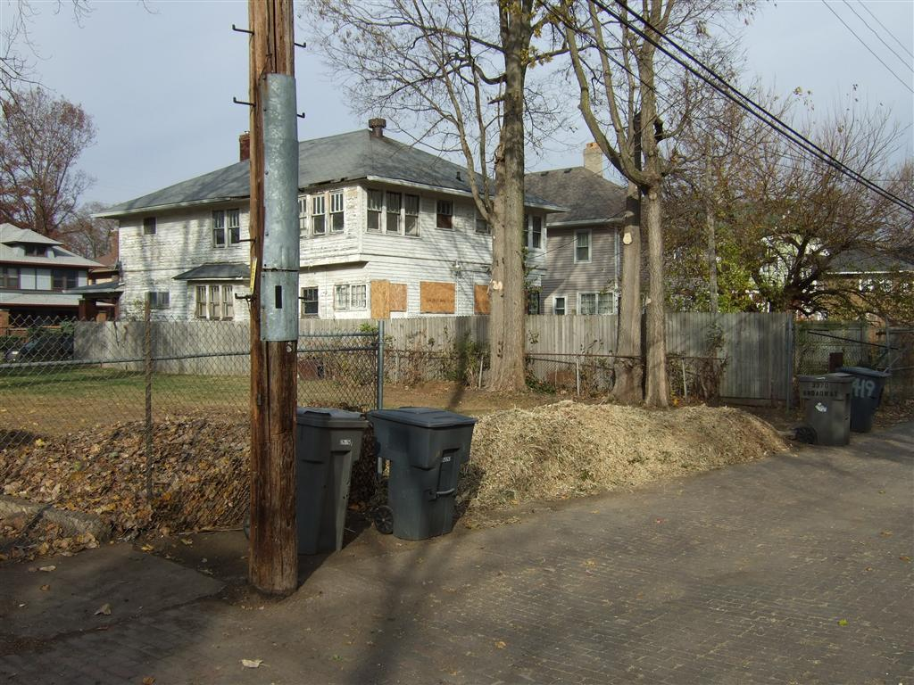
Community Engagement “Chip Happens”
2010

Slide 8
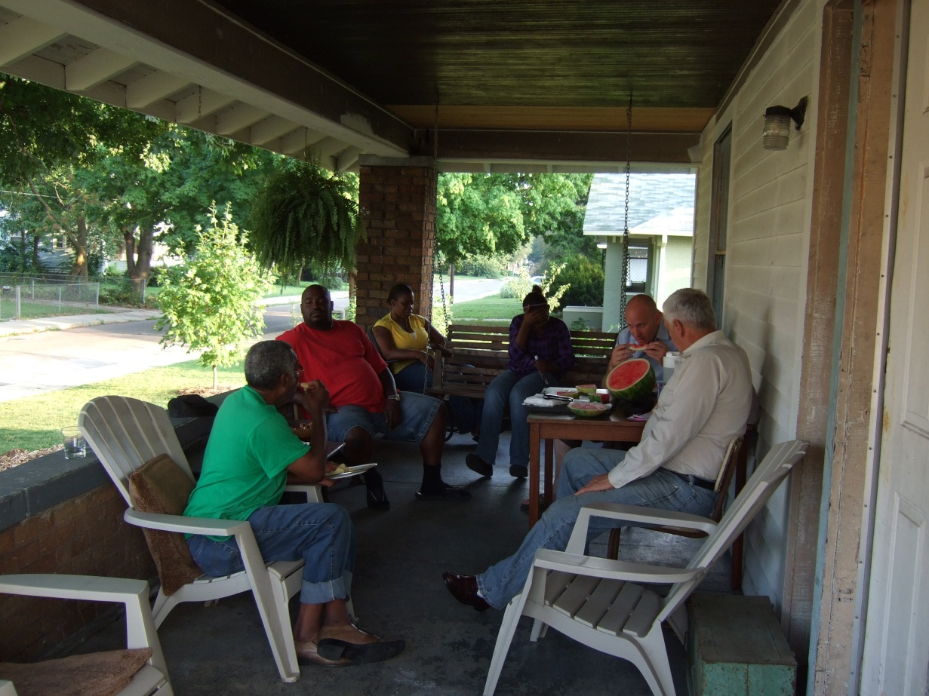
Community Engagement Broadway Area Neighbors Group
social connections
“stay in your square”
shared experiences
blight, drugs, crime
empowerment
solutions, not problems
BANG!
builds trust

Slide 9
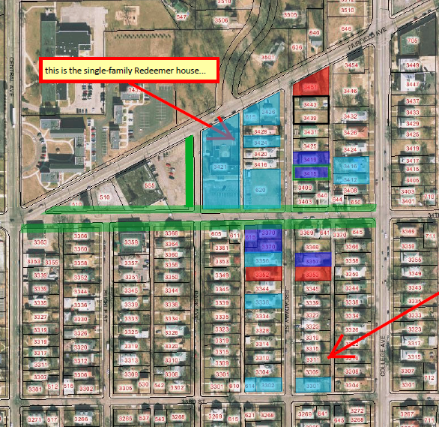
Community Development Broadway Area
public space
litter cleanup, tree planting
acquisition & rehab
opportunistic, targeted
Double 8 Rain Garden
beautification
education
environment
Broadway Community Garden

Slide 10
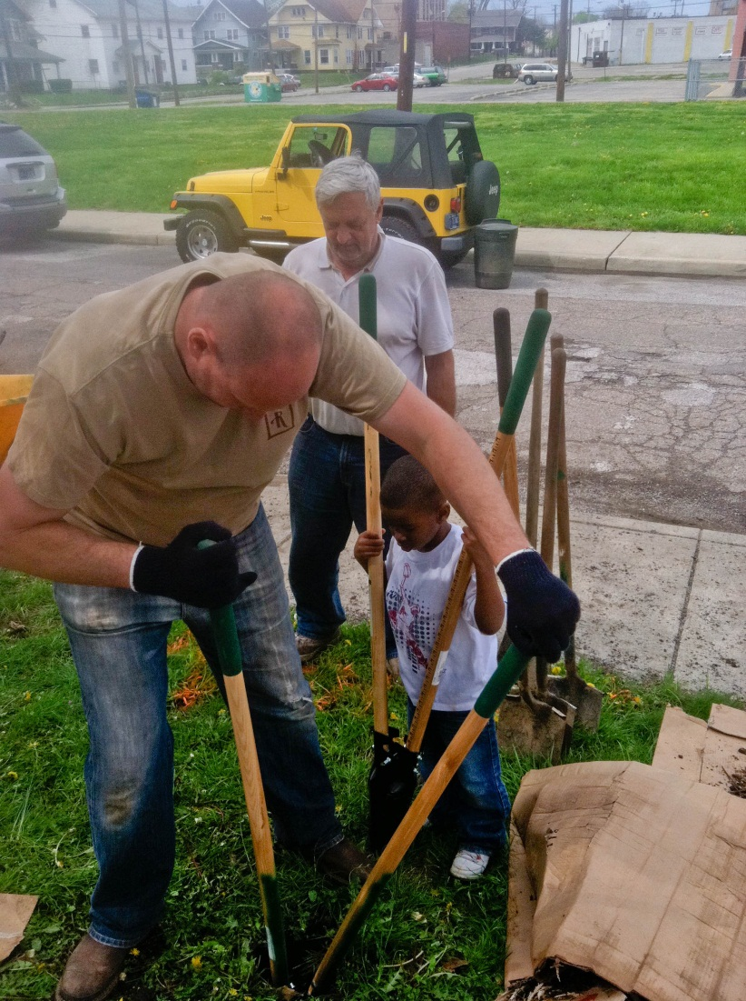
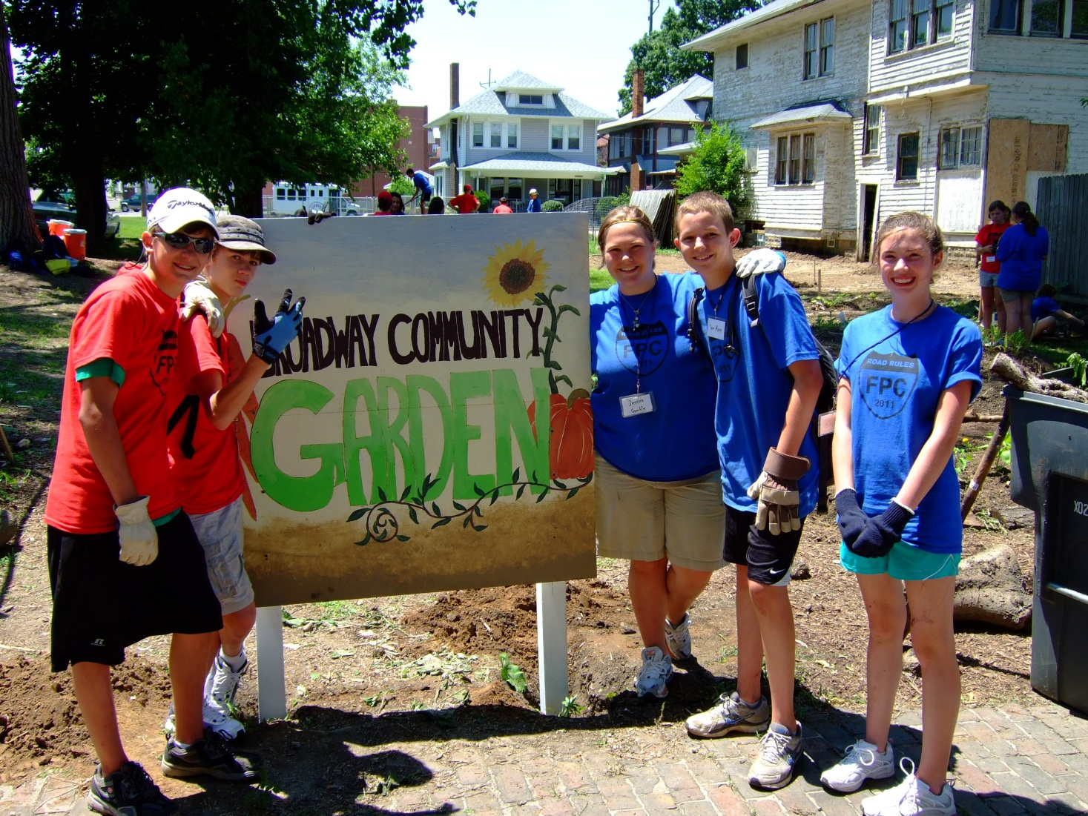
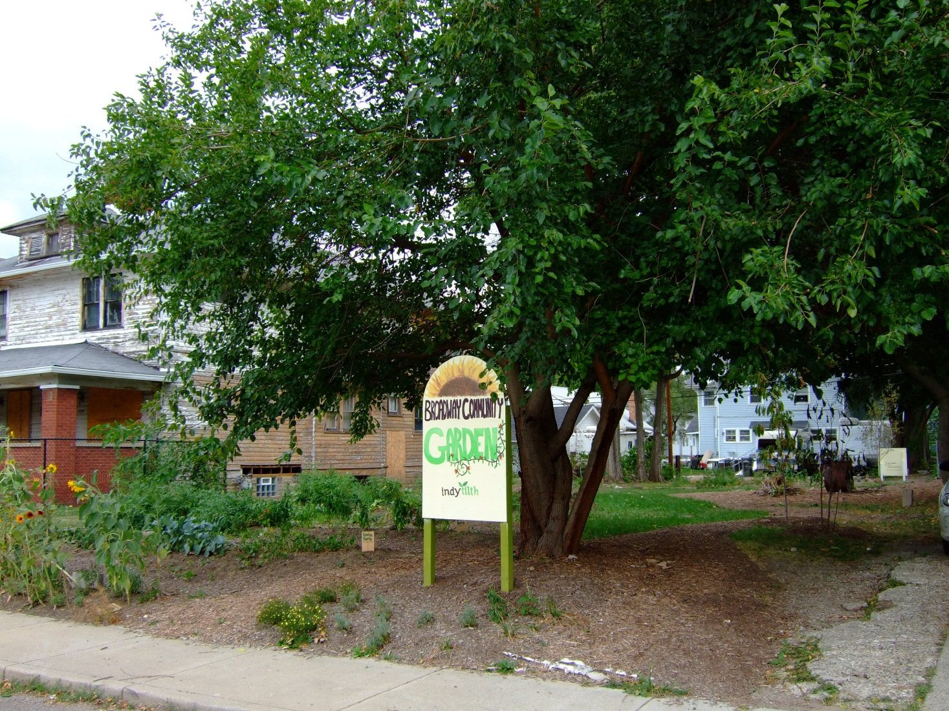
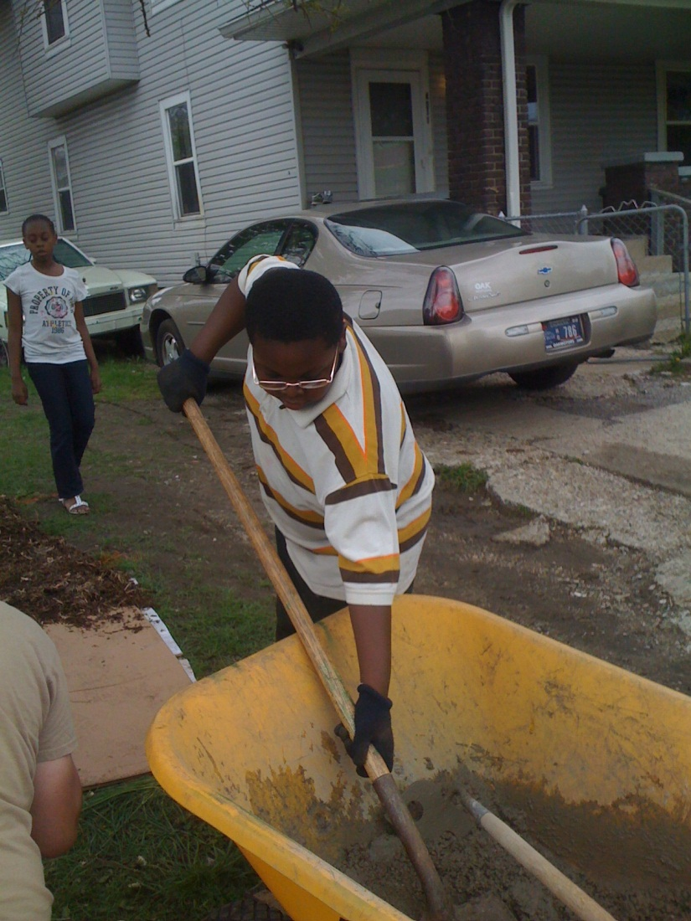
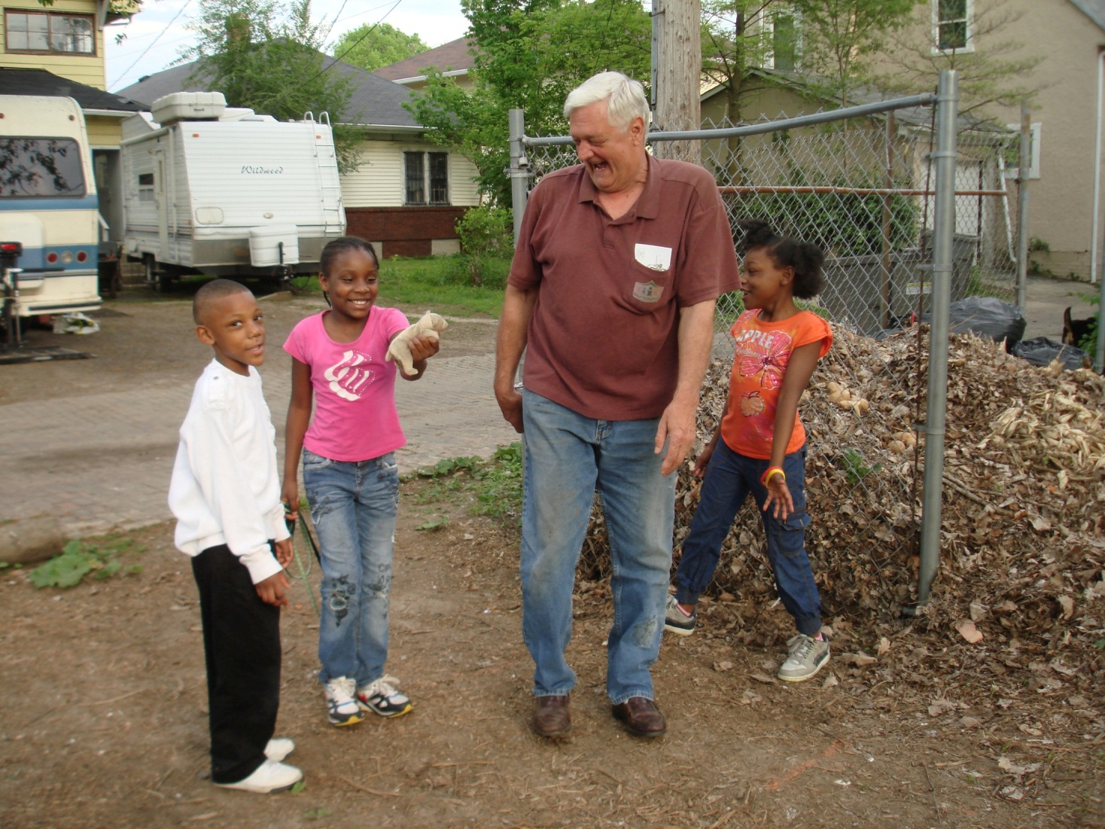
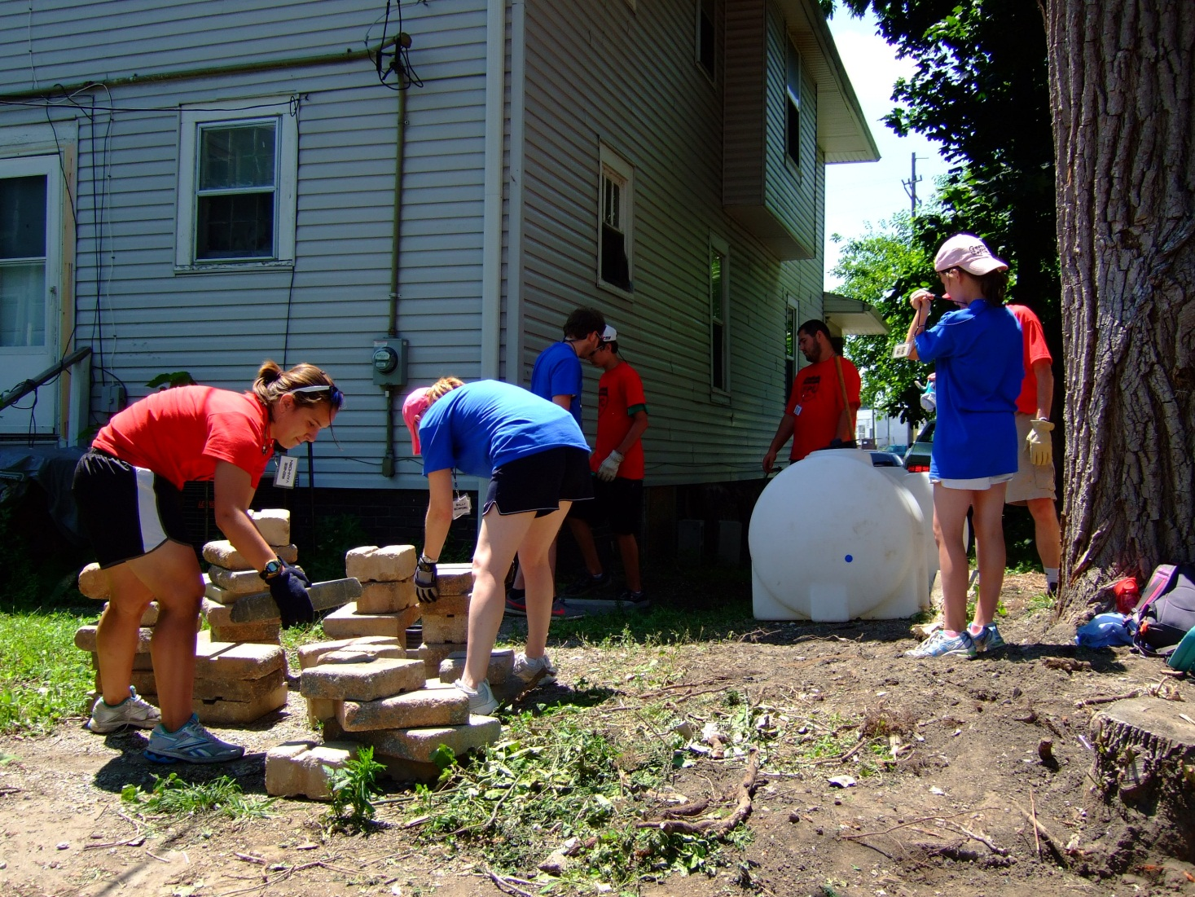
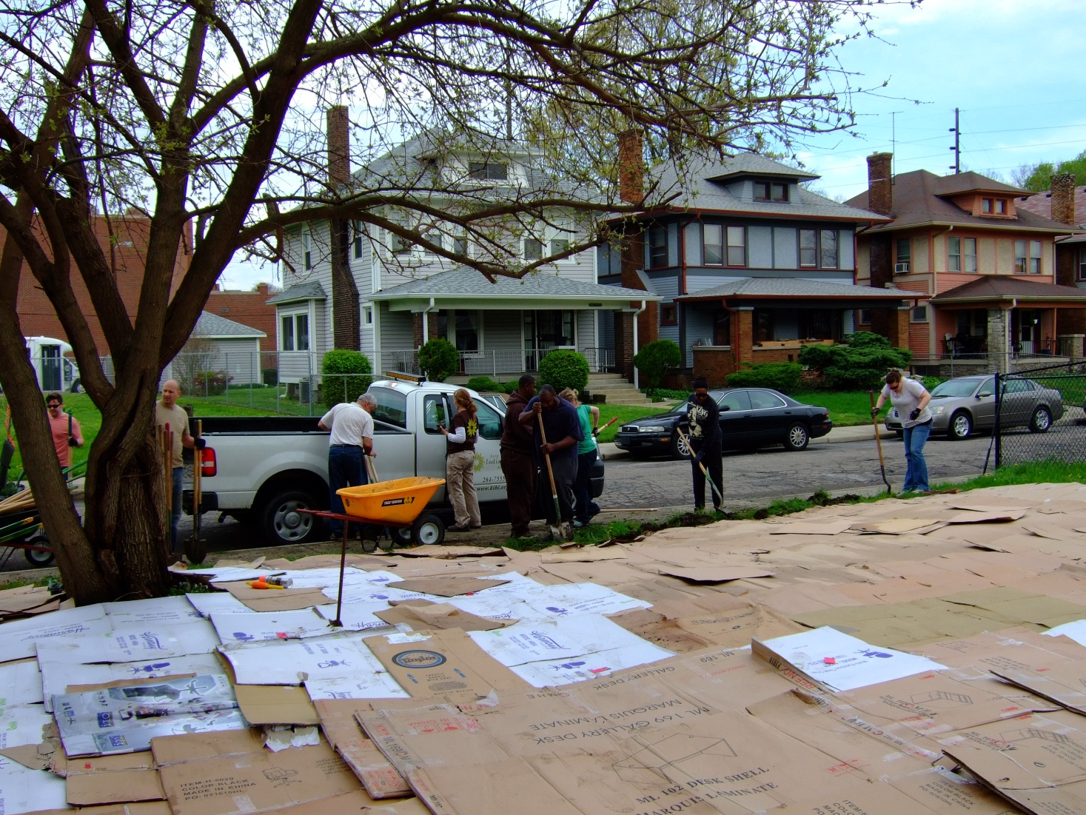
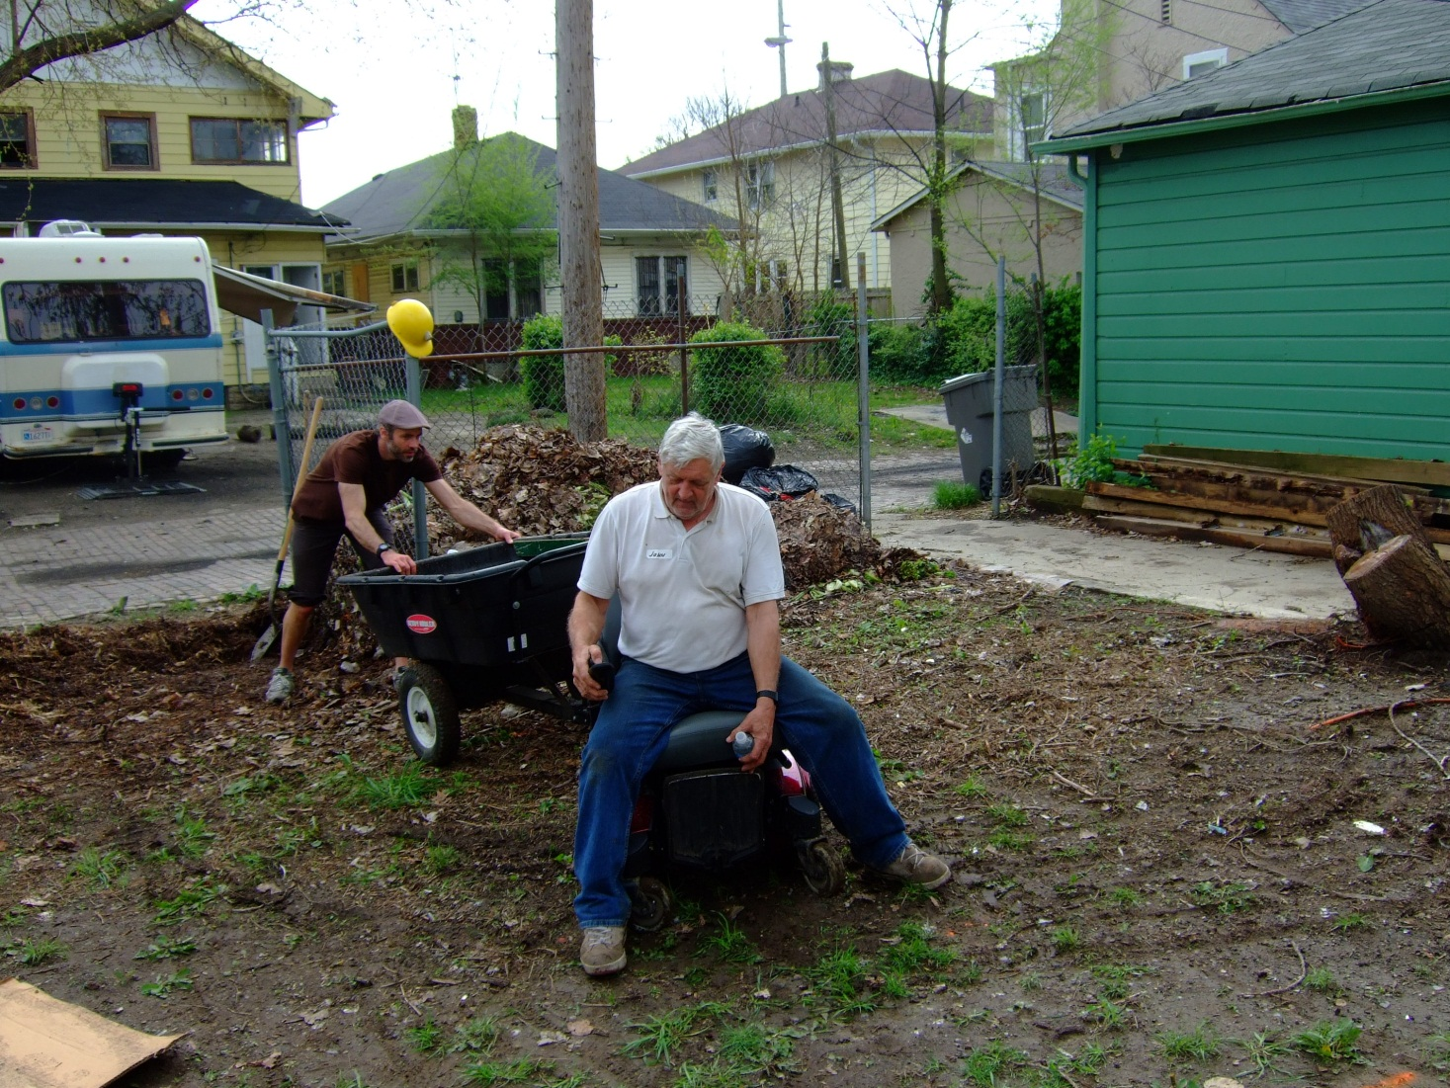
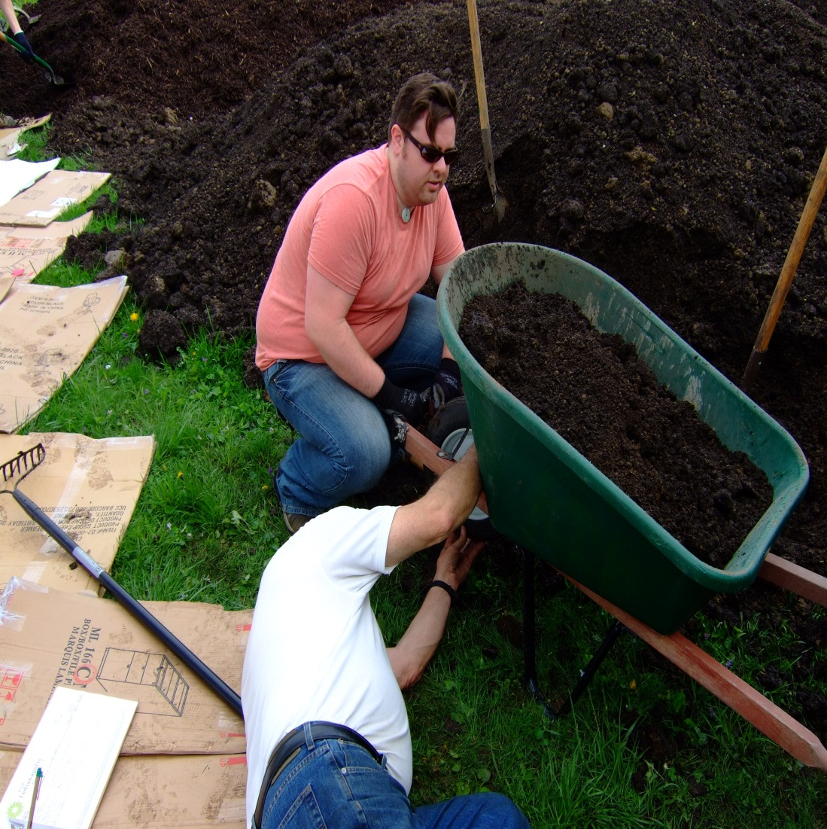
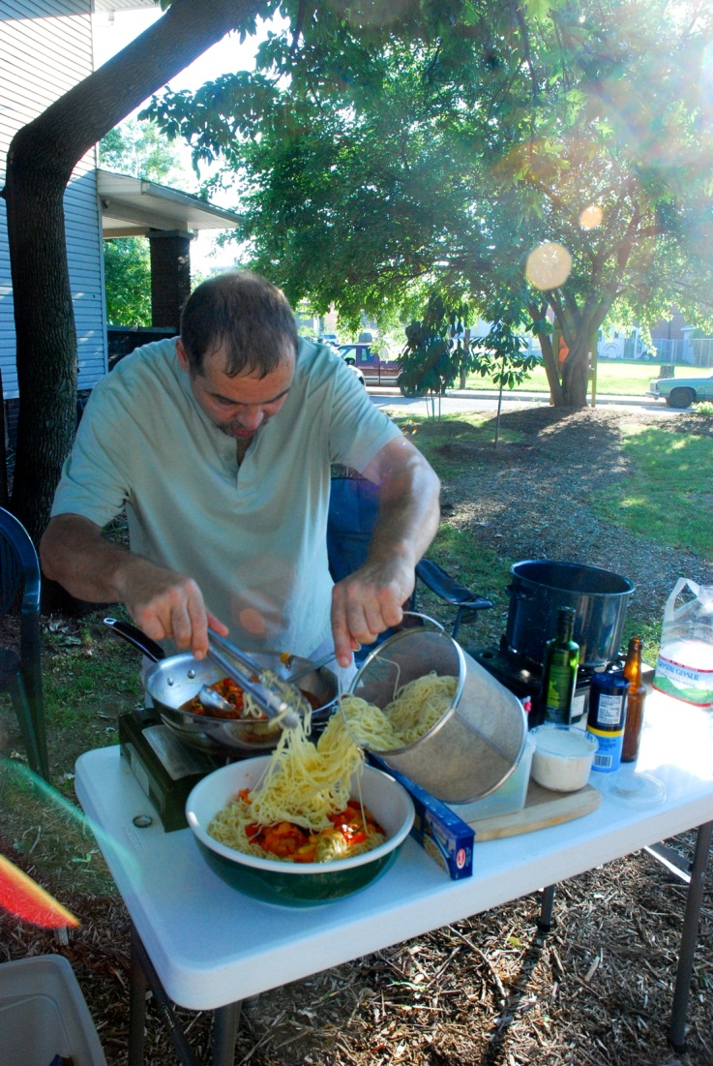
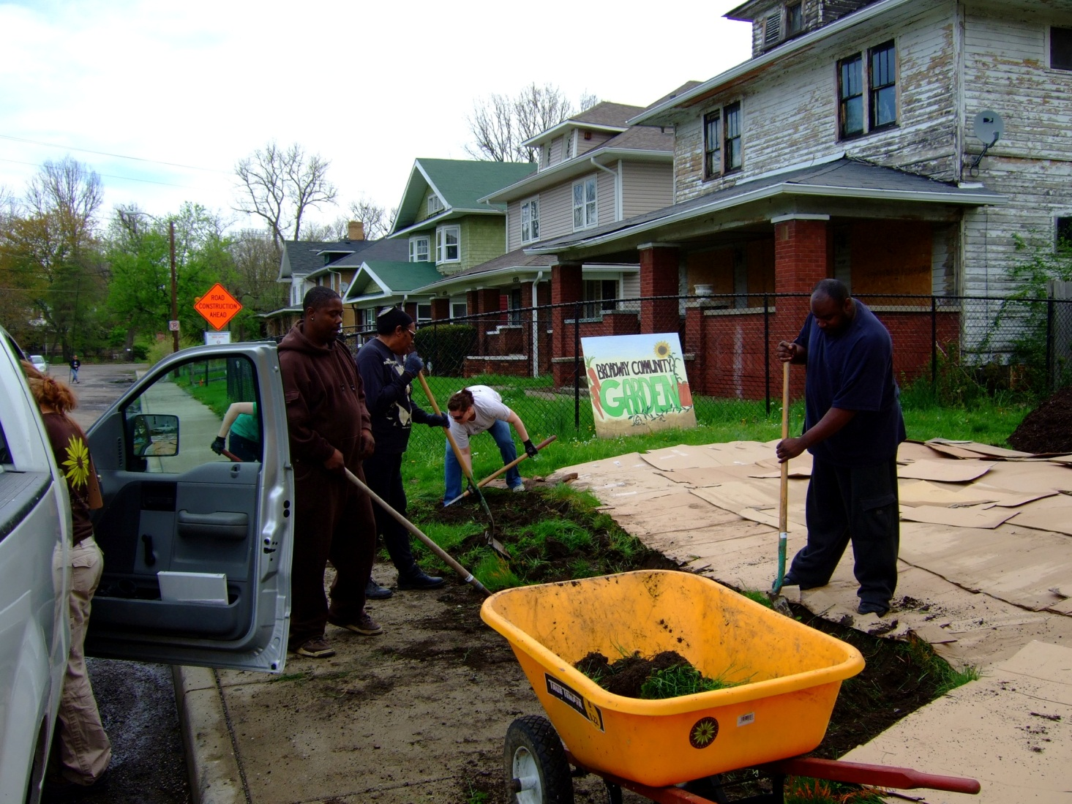
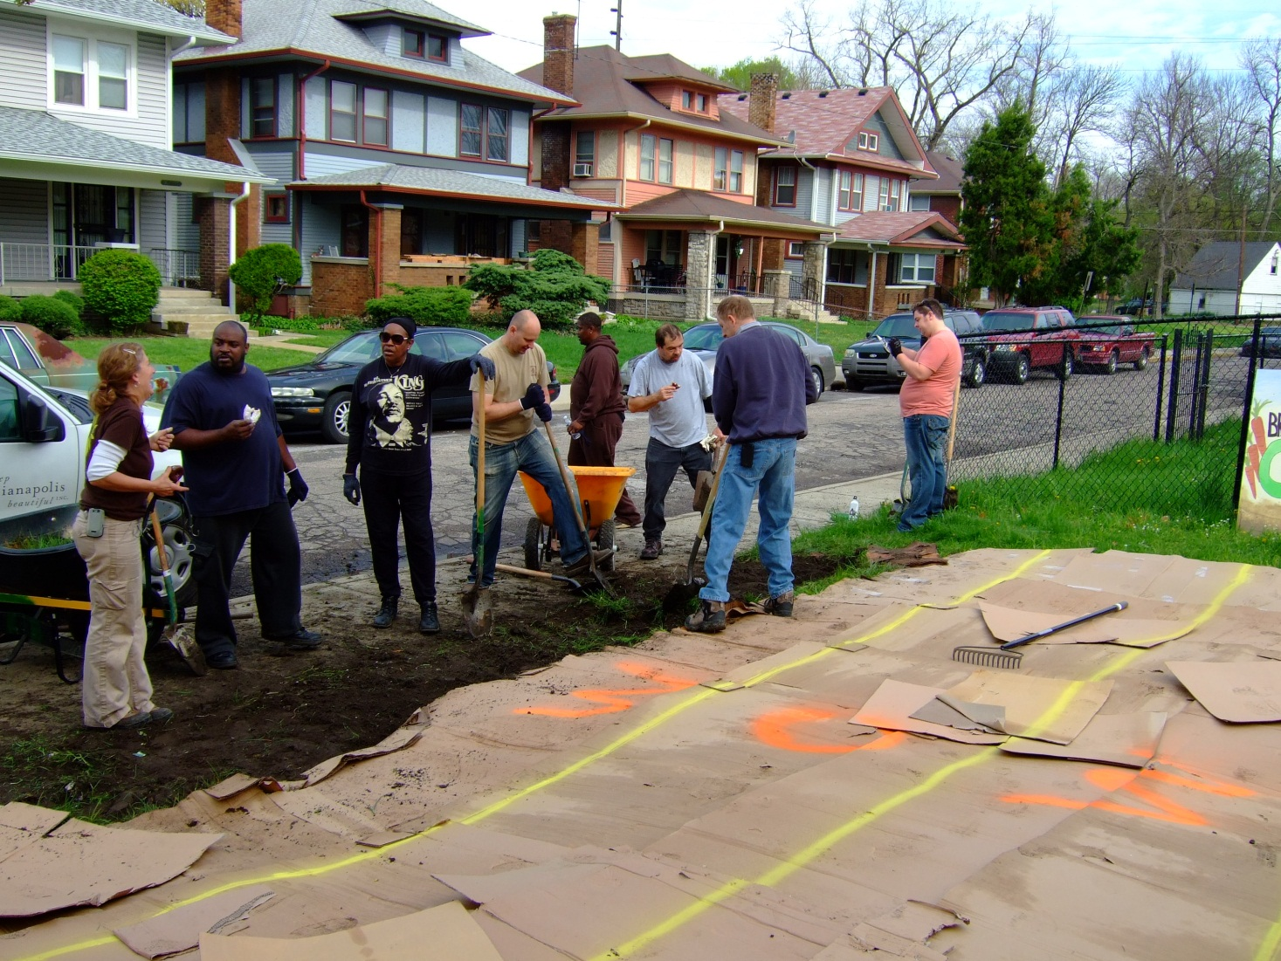
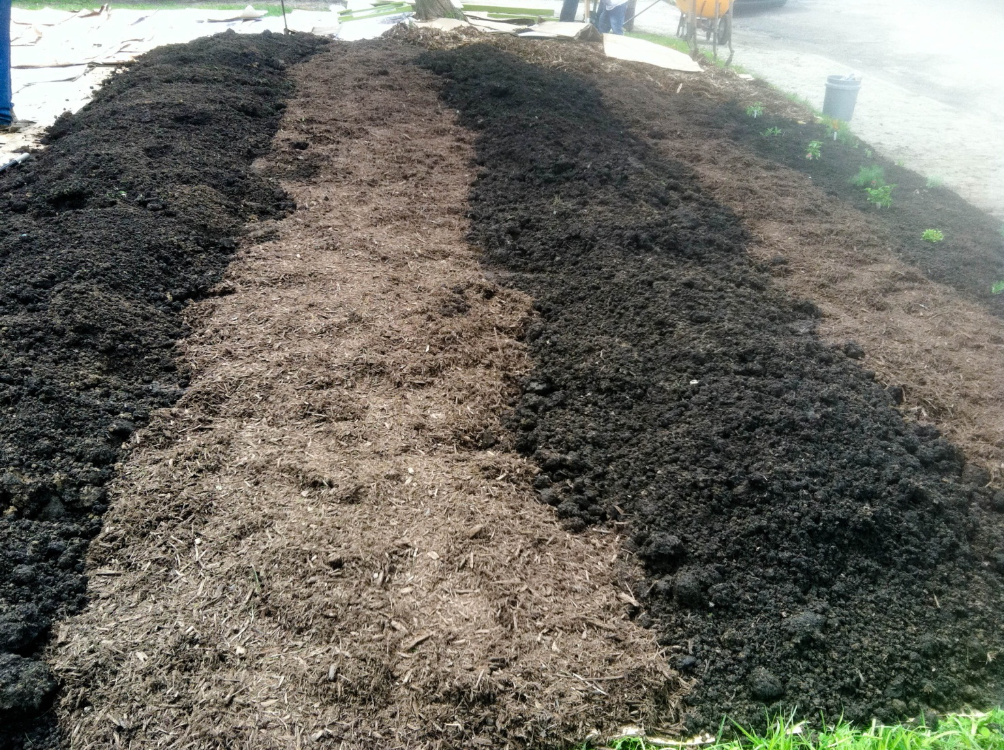
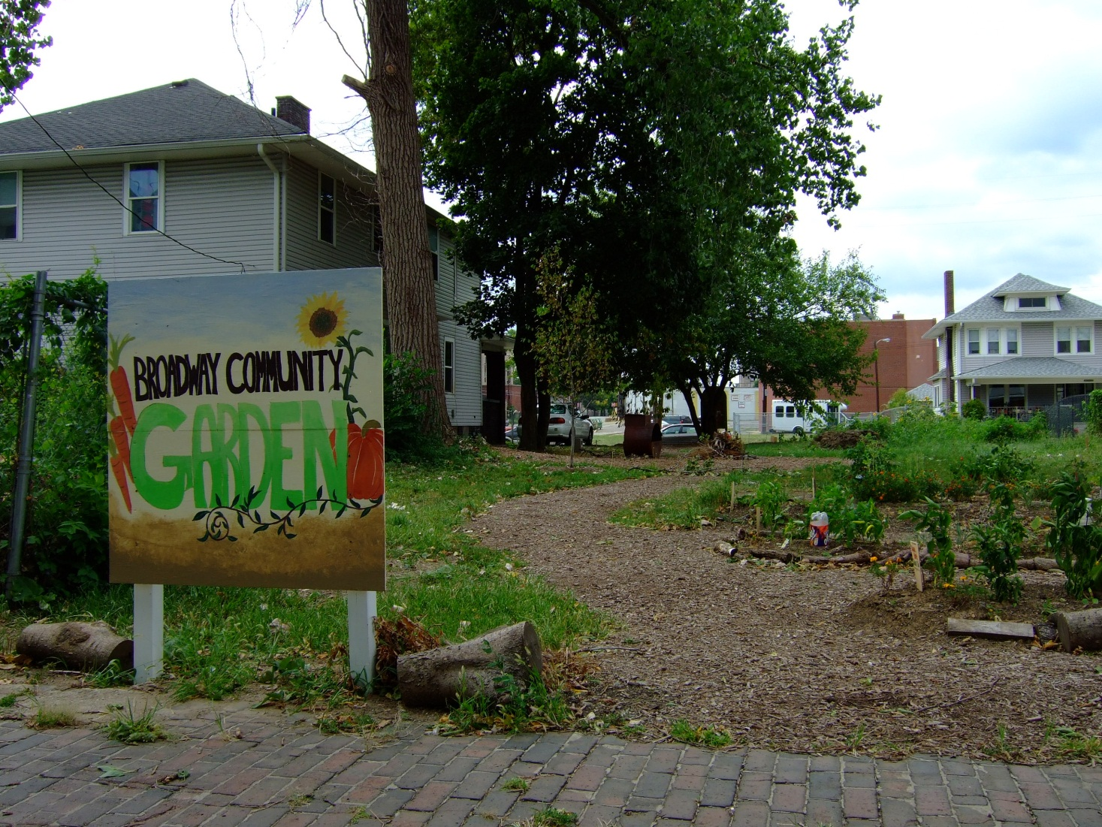
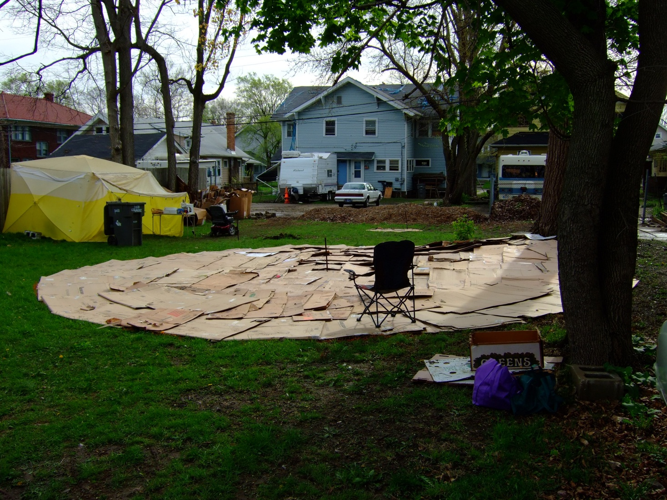
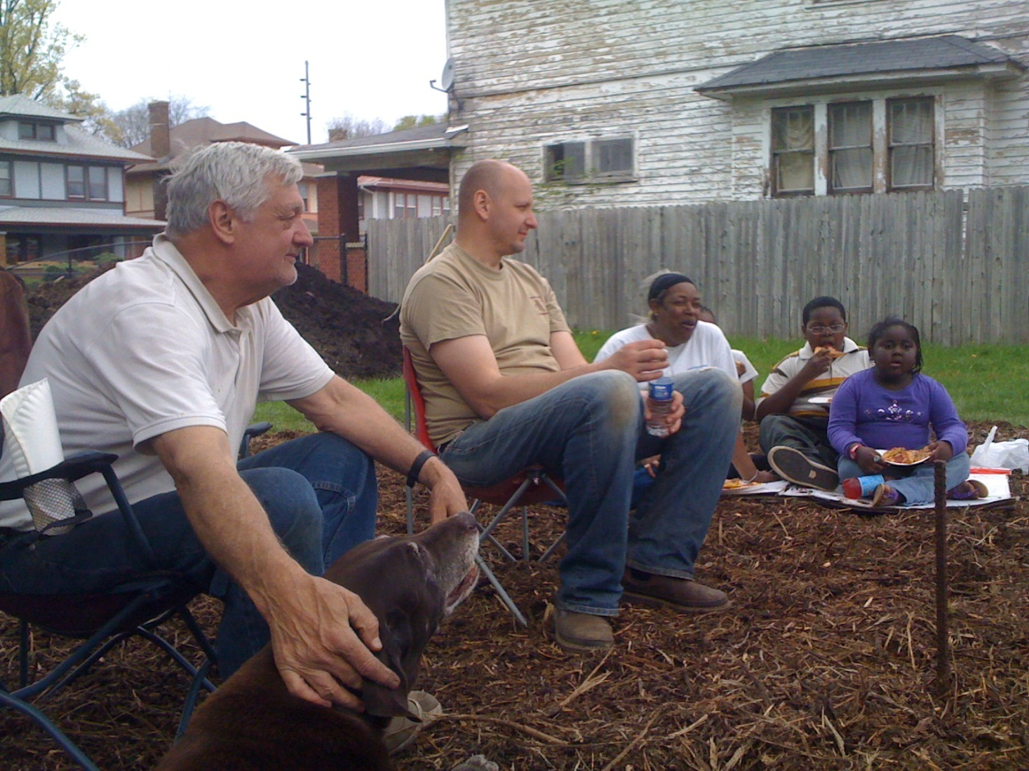
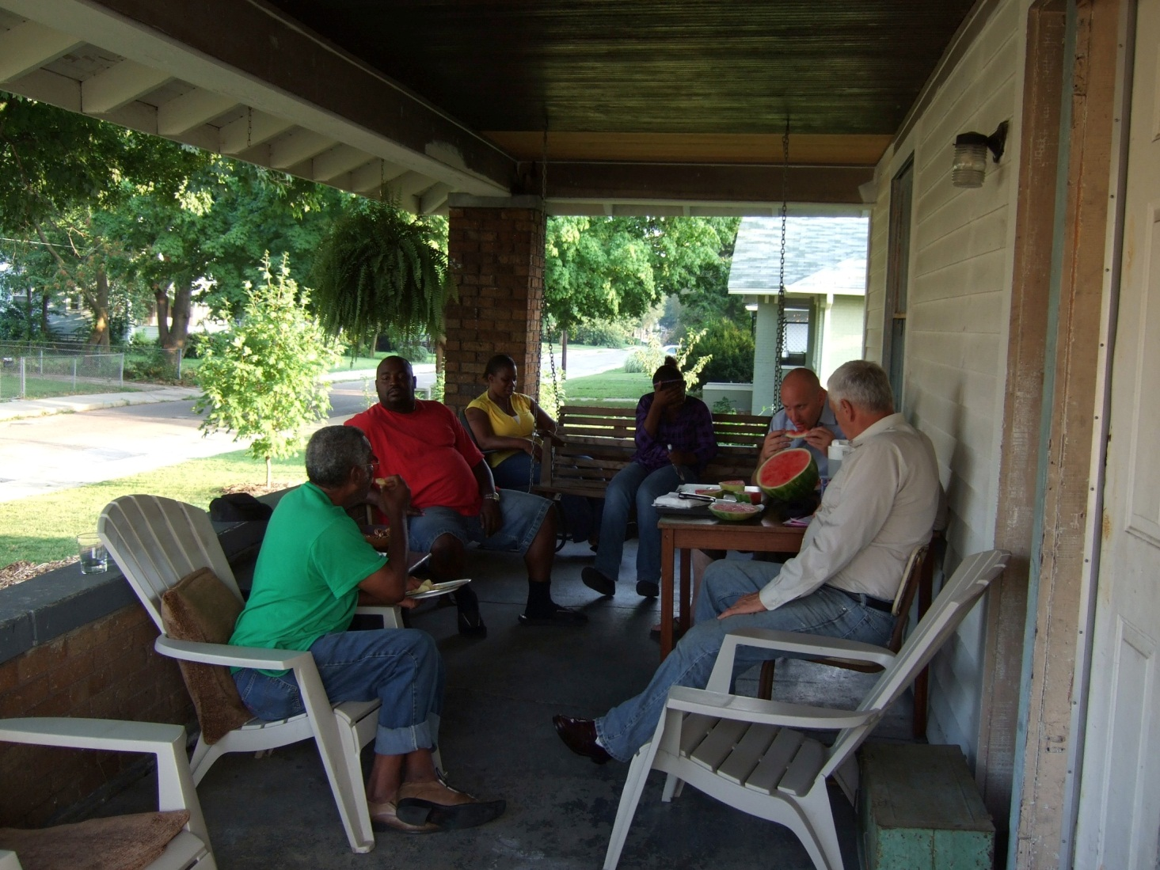
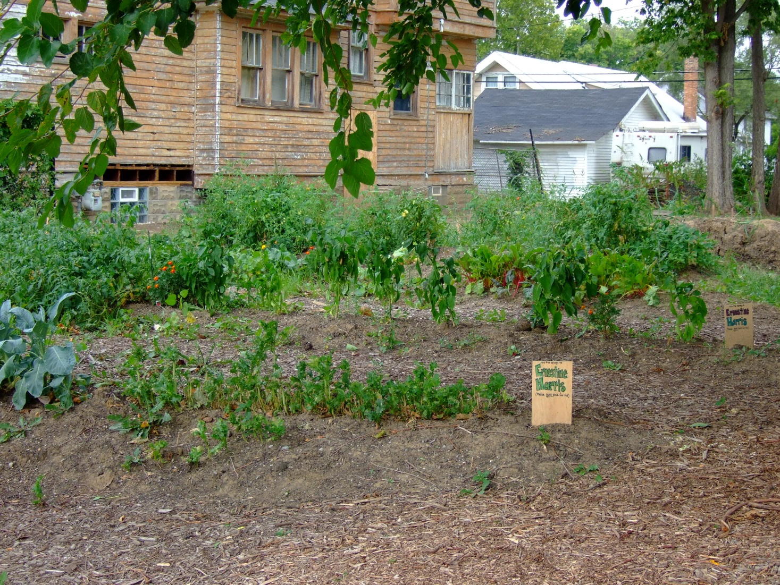
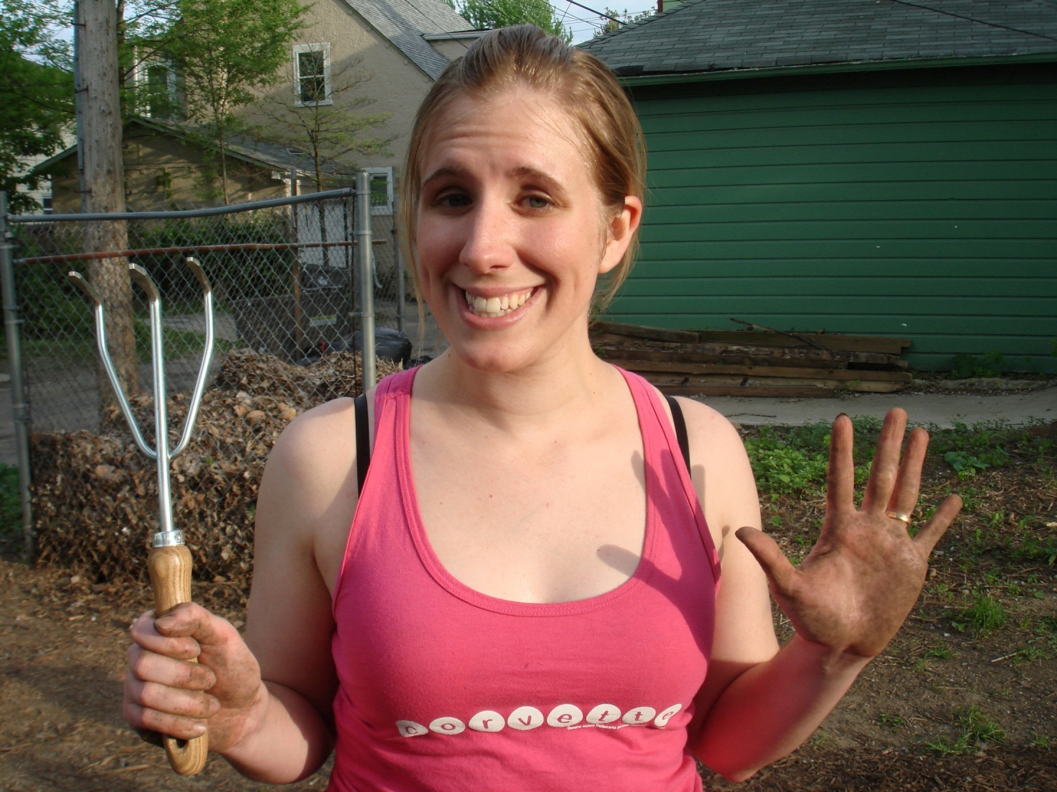
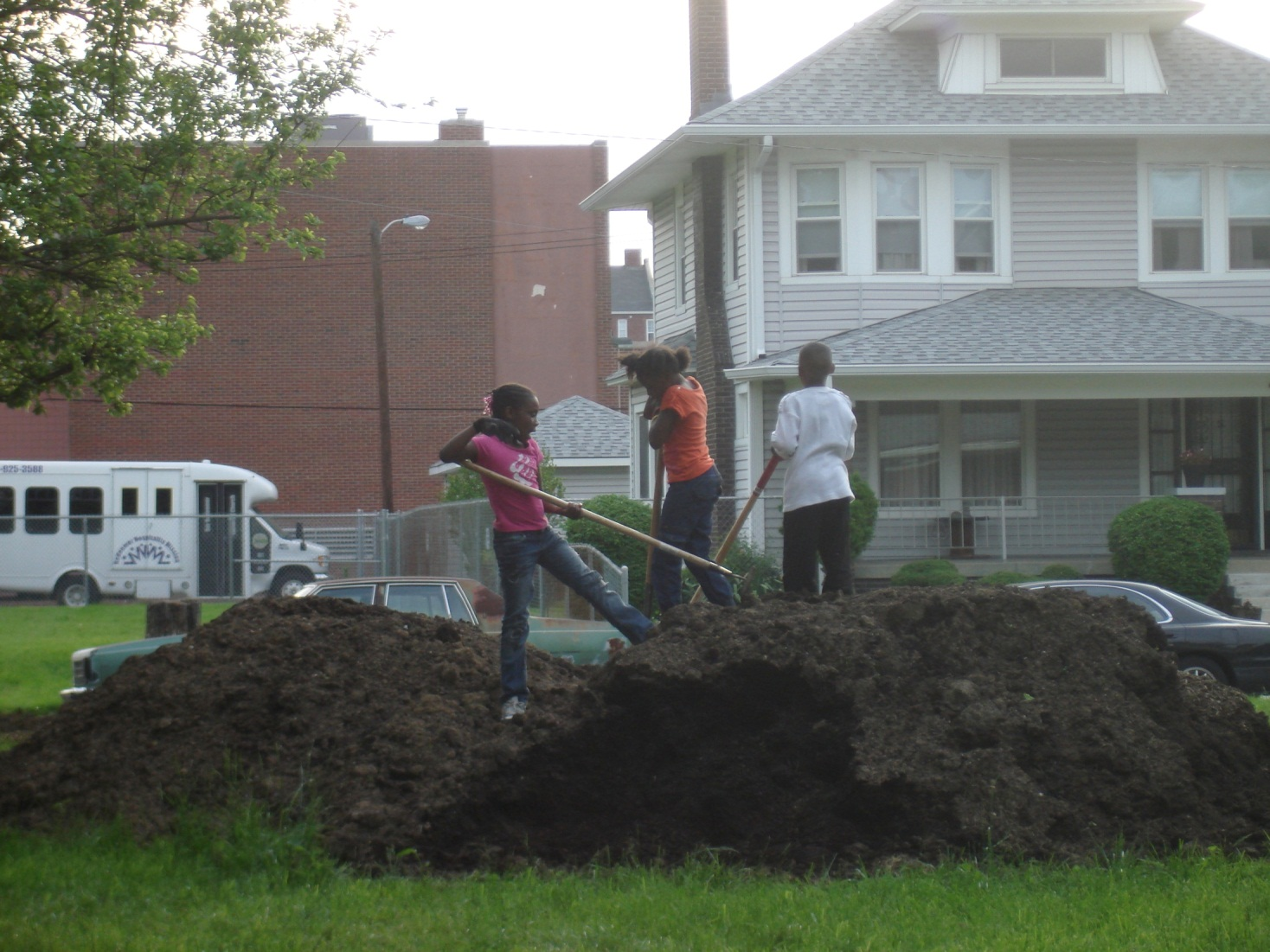
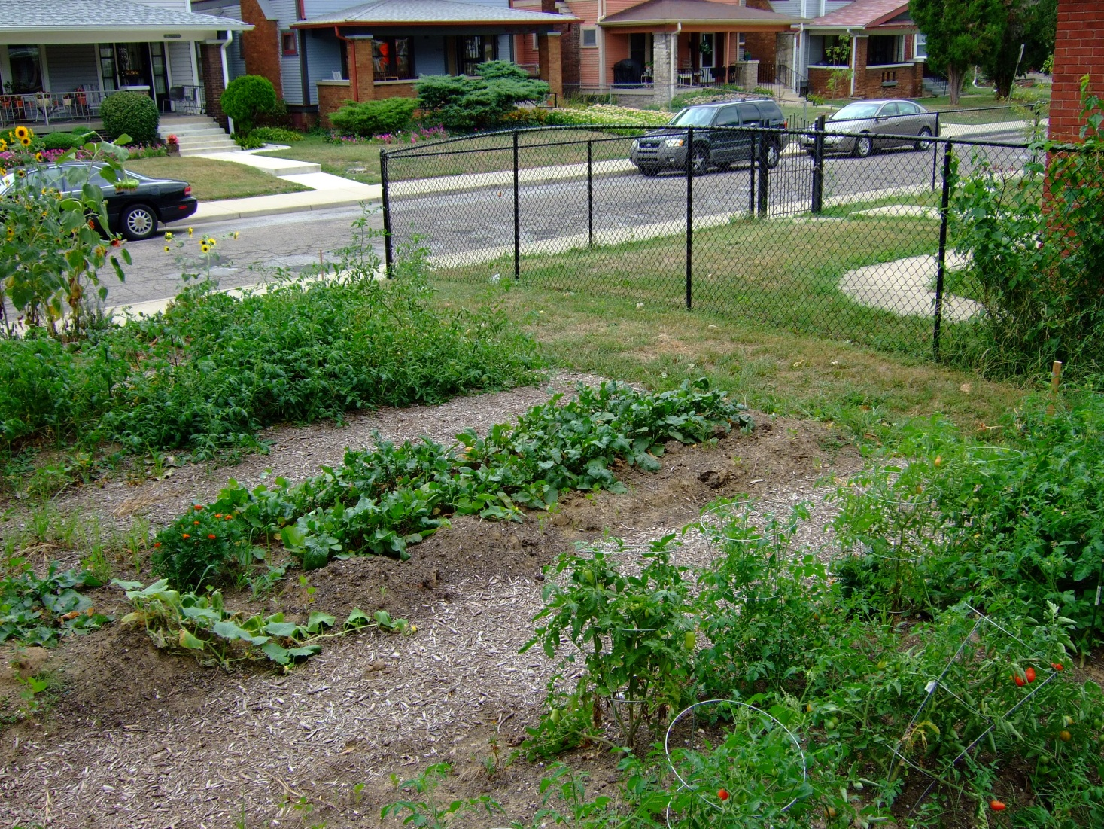
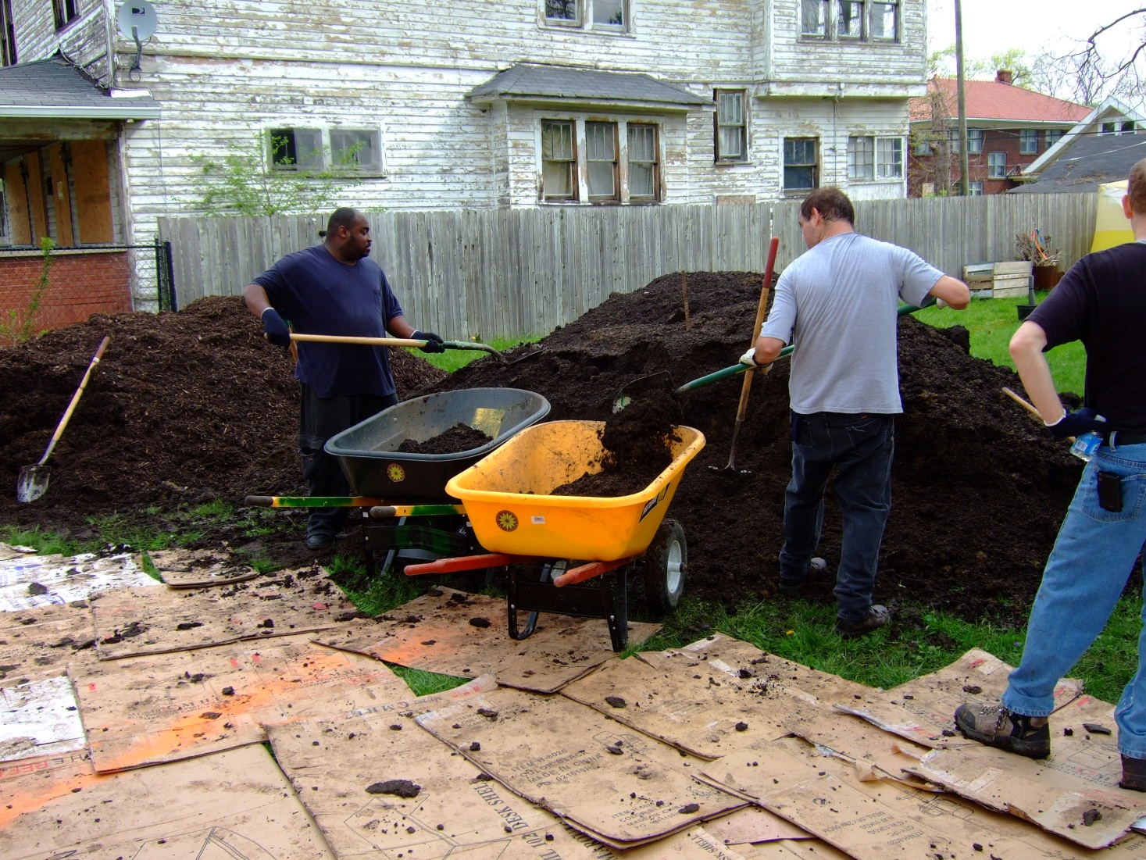
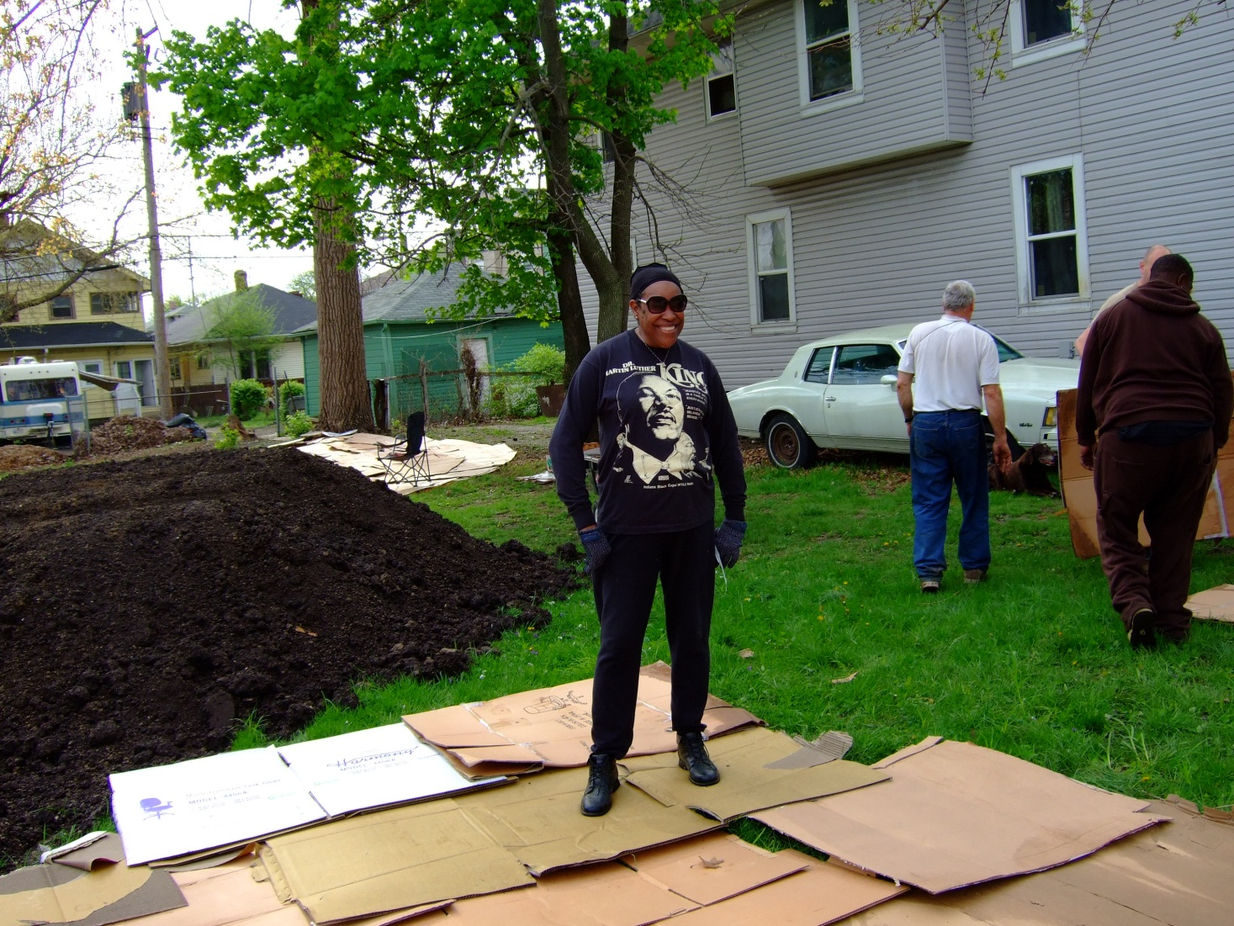
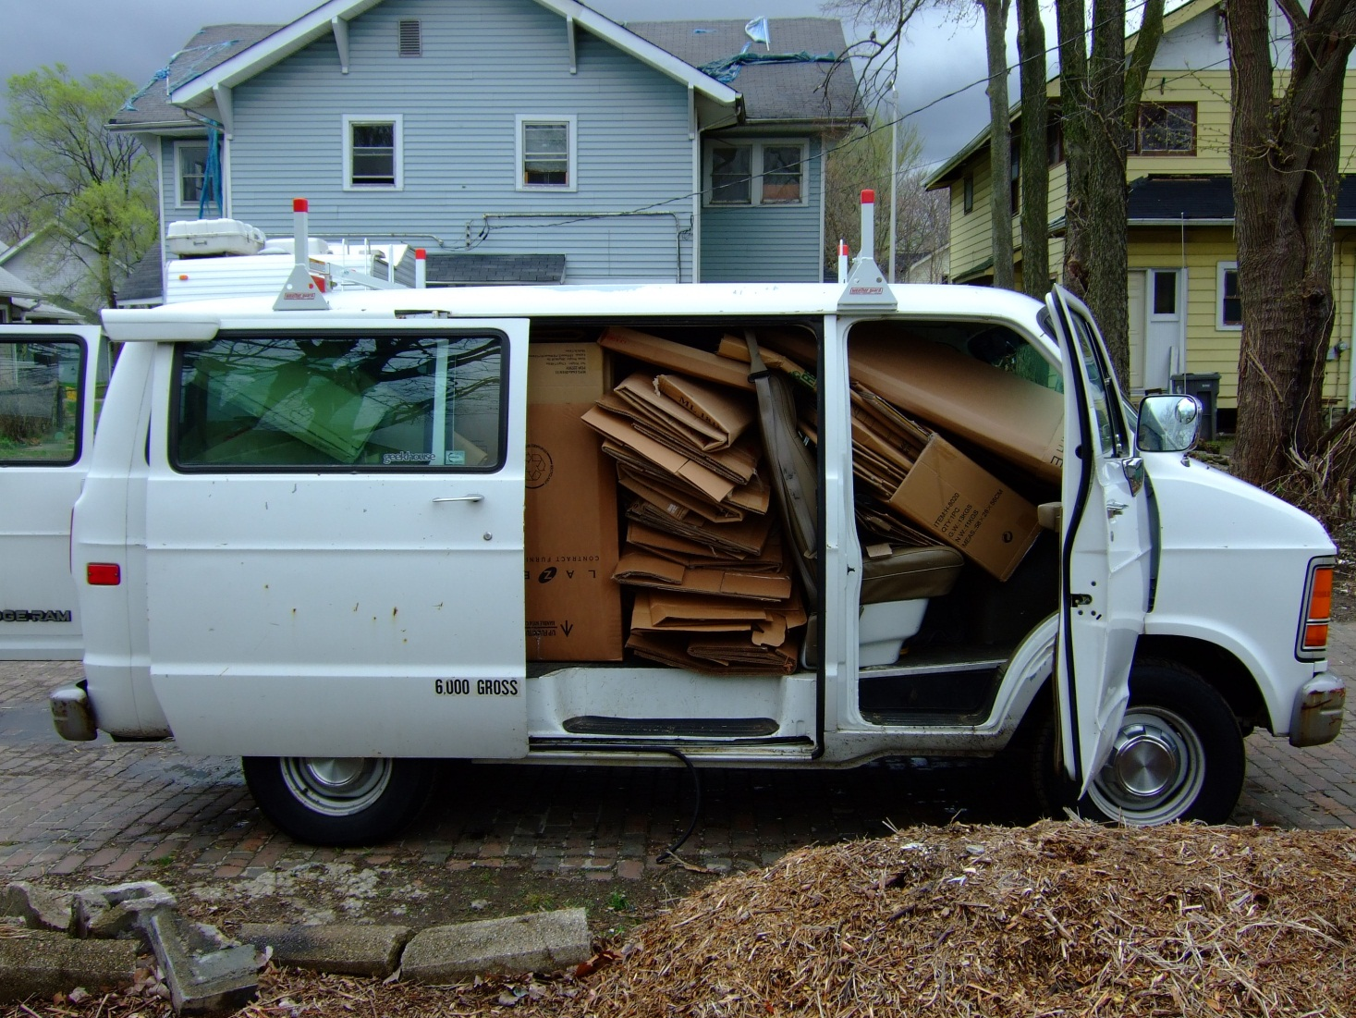
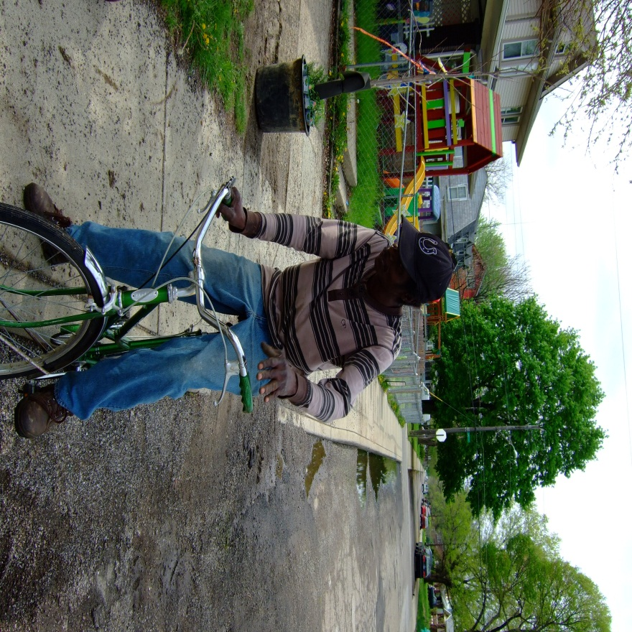
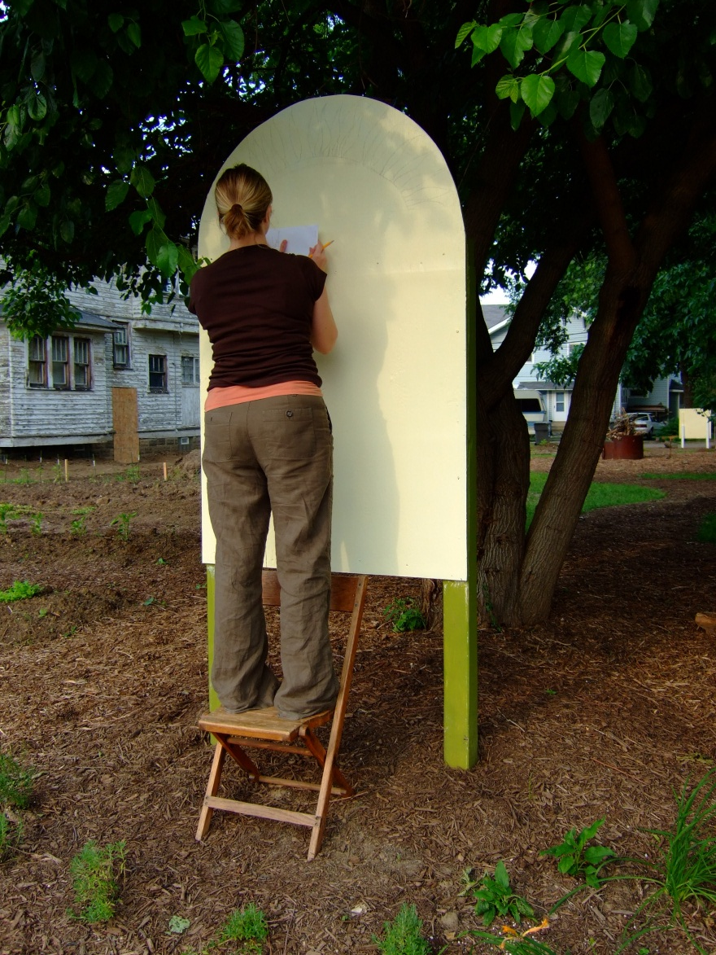
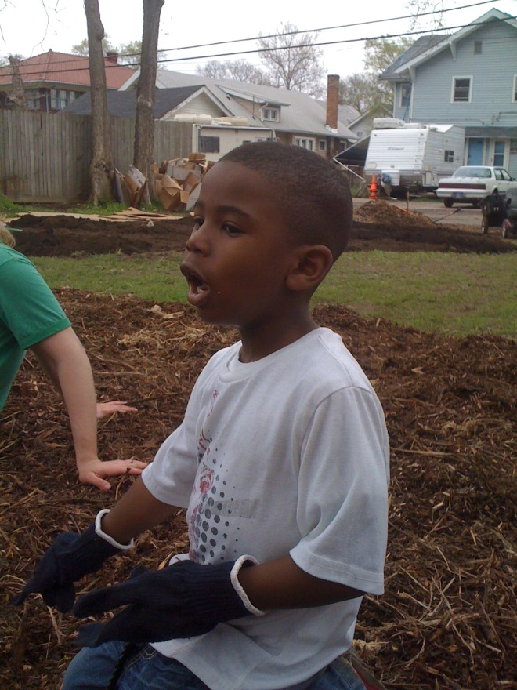
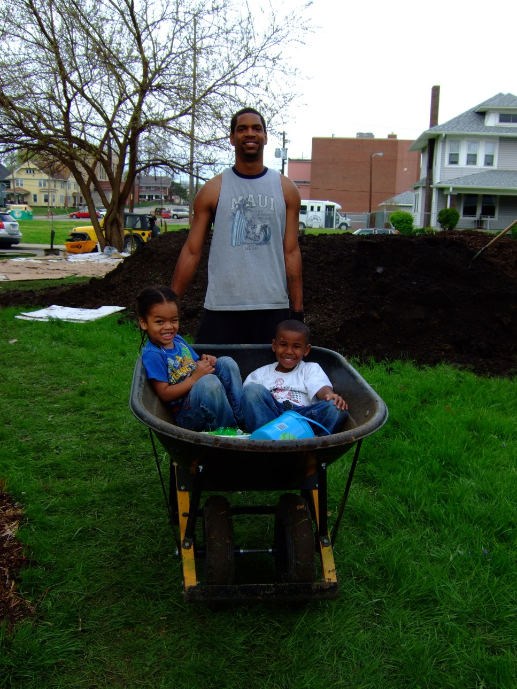
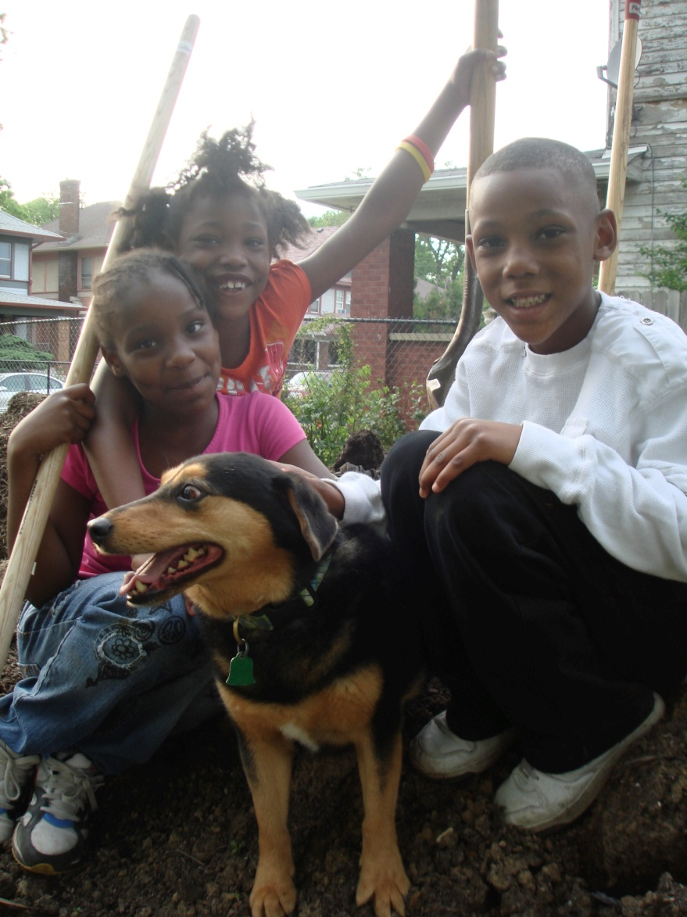
Broadway Community Garden

Slide 11
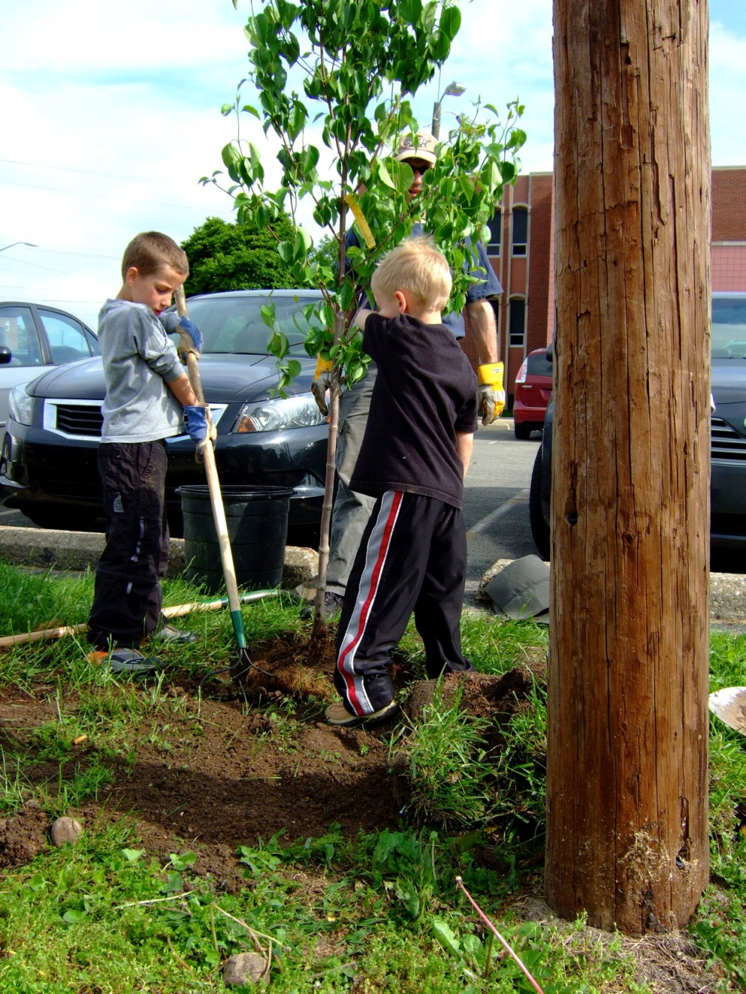
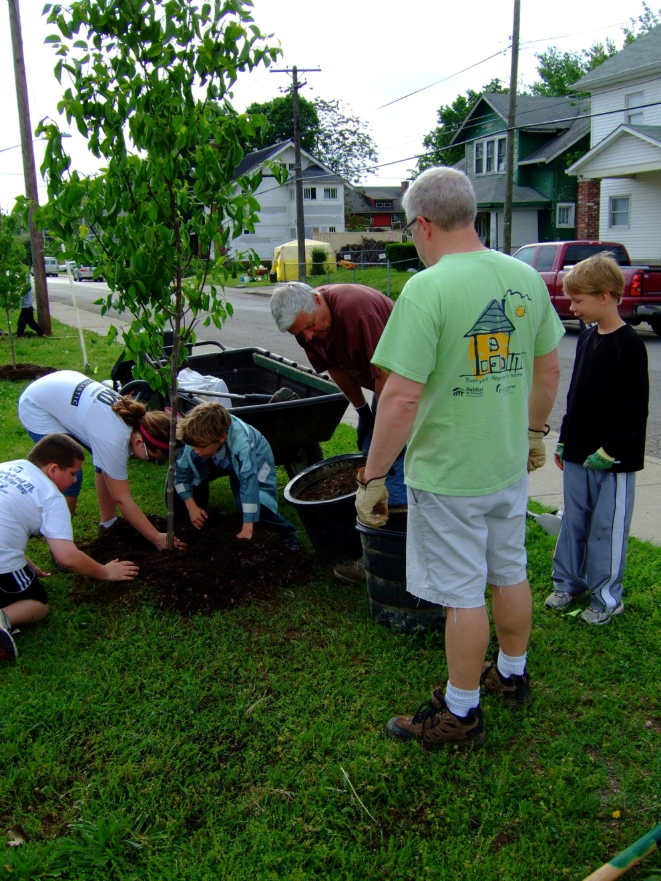
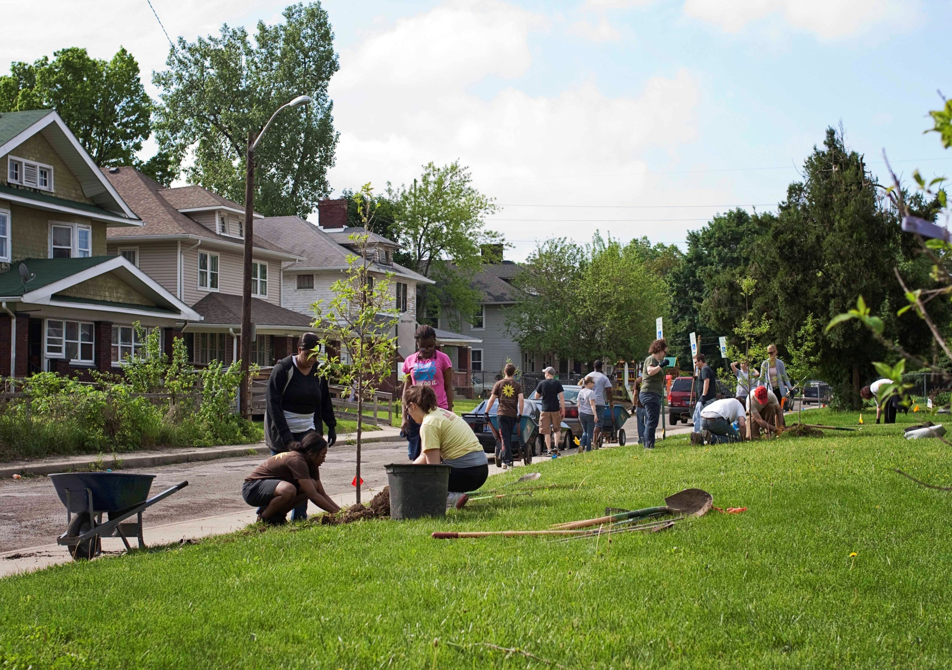
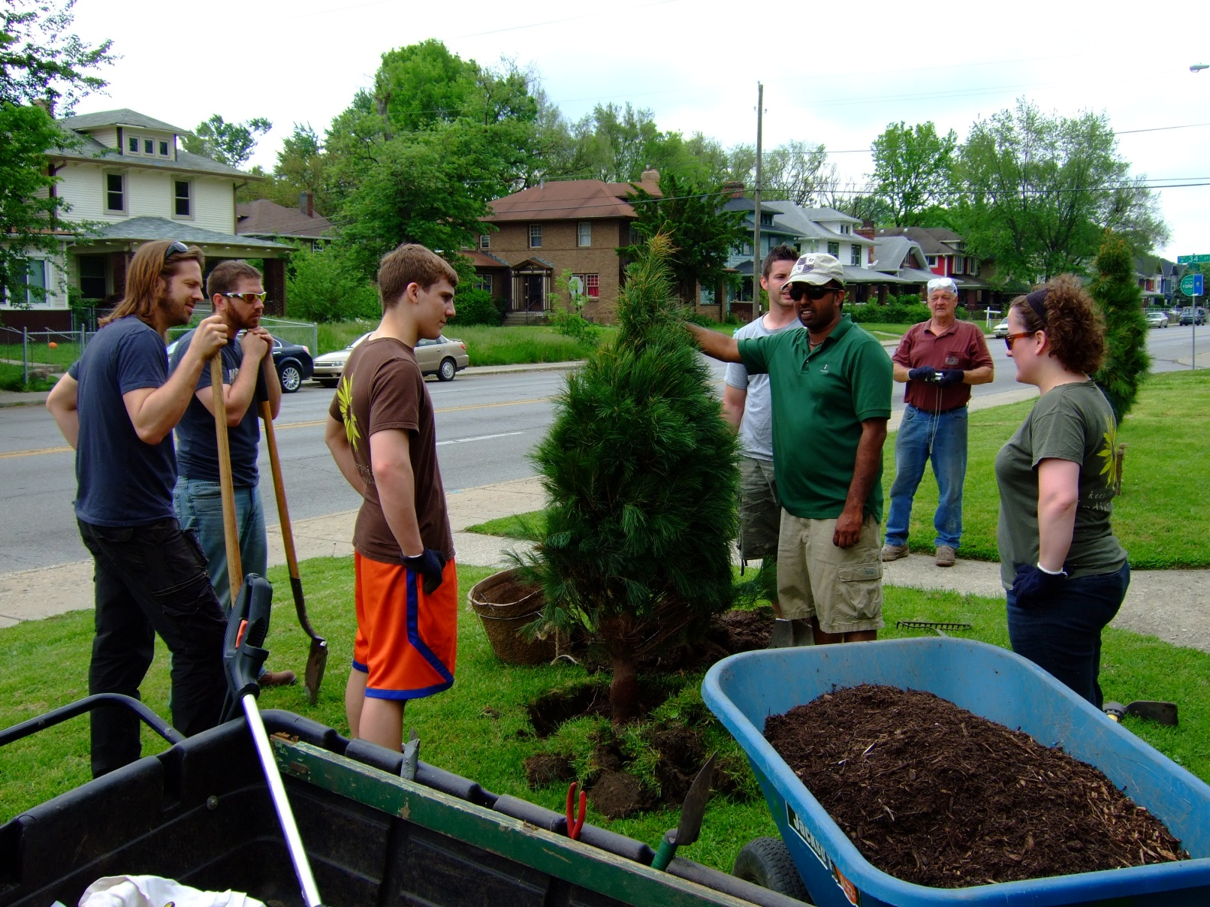
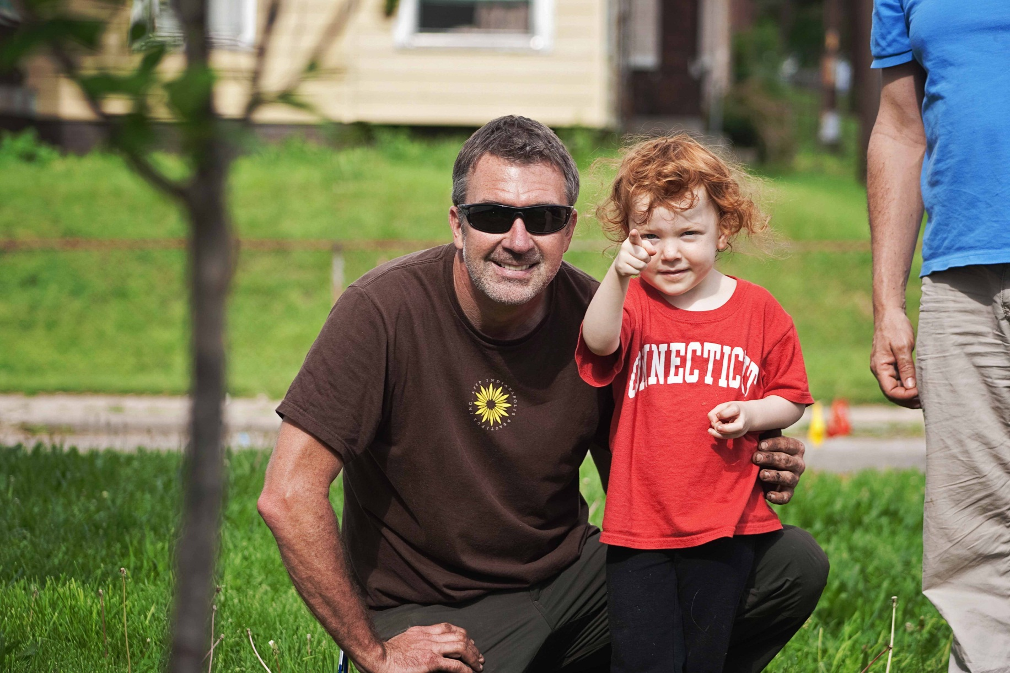
Tree planting

Slide 12
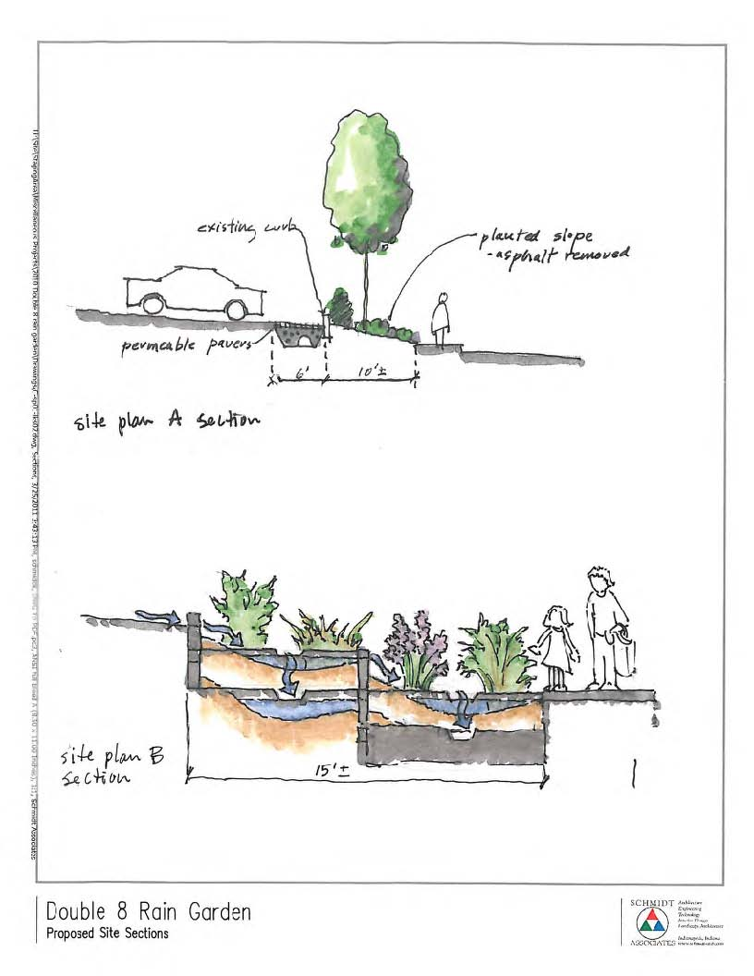
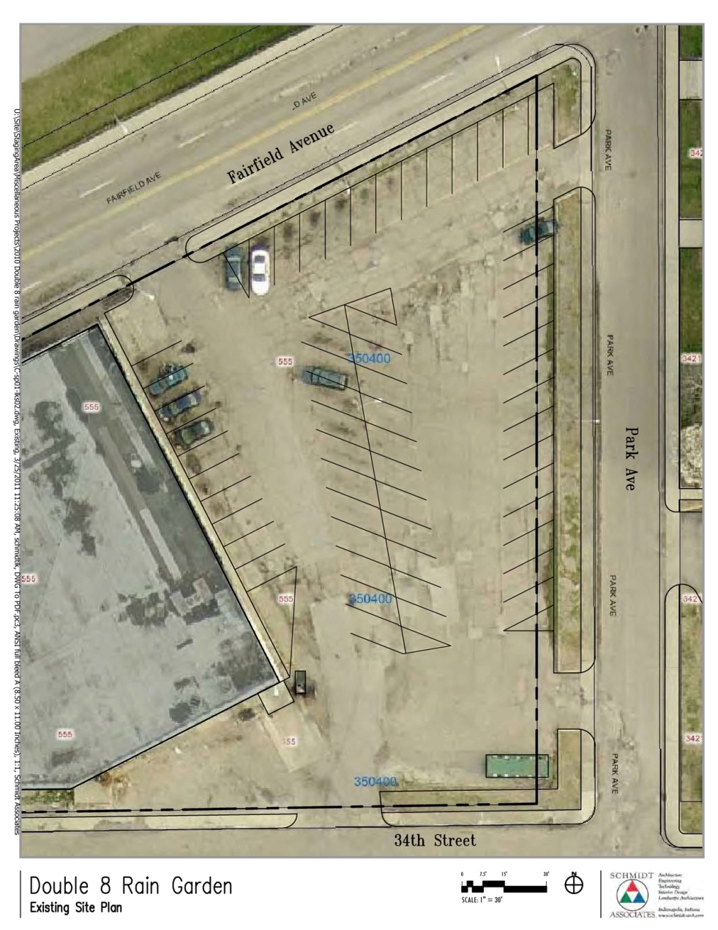
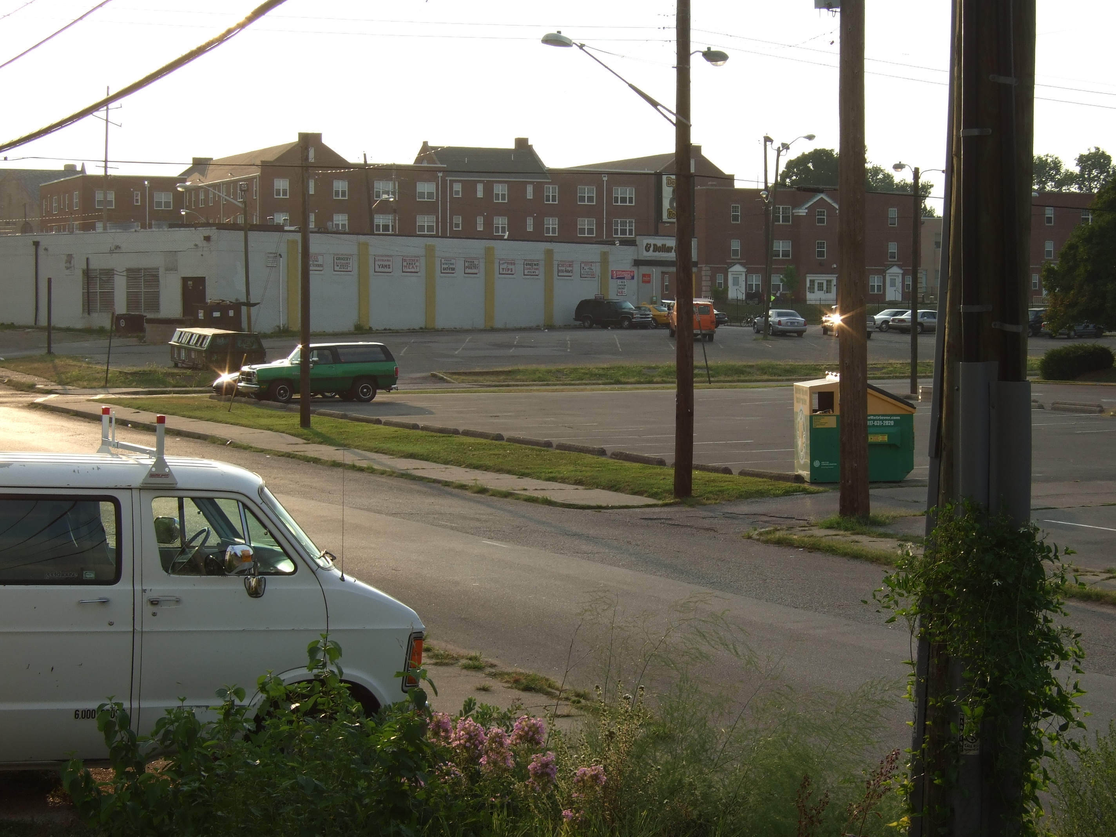
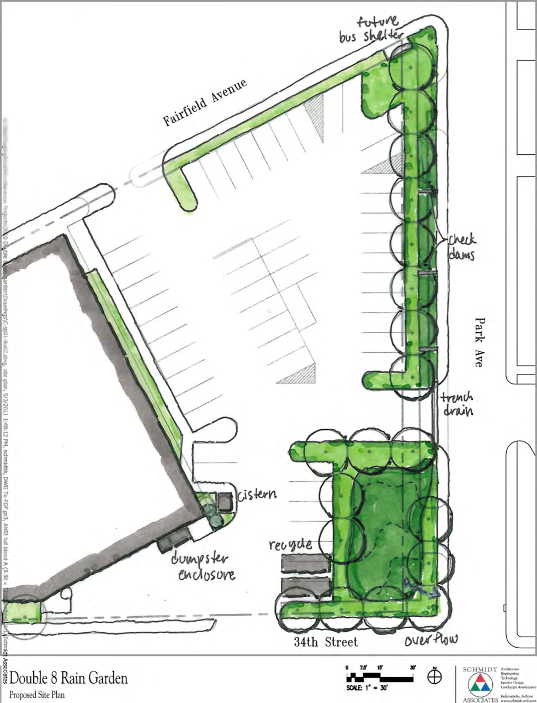
Double 8 Foods Rain Garden

Slide 13
LEED Leadership in Energy & Environmental Design
evidence-based
building science
best practices
AIA, NAHB, FSC, etc.
consensus approval
industry, gov’t, advocates
evolving standard
3-year update cycle

Slide 14
LEED-ND LEED for Neighborhood Development
Smart Location & Linkage
greenfield vs. infill, transportation
Neighborhood Pattern & Design
place making, public space, goods & services
Green Infrastructure & Buildings
energy & water
A Citizen’s Guide to LEED-ND
NRDC – Natural Resources Defense Council

Slide 15
LEED-ND in practice Mapleton-Fall Creek Development Corporation
engagement tool
board of directors
committees
yardstick
internal improvement
August 2011 charrette
USGBC, LISC, NRDC
Agora Group, raimi + associates
certification?
wasn’t a priority, but…

Slide 16
LEED-ND MFCDC August 2011 Charrette Scorecard

Slide 17
LEED-ND Certification Documentation
IndyGo “sweet spot”
key discovery
residential density
density supports transit & retail
pursue senior housing projects
recommendations
market MFC as transportation “sweet spot”
continue to create diverse housing mix
continue to create connectivity
continue & expand green building

