Slide 1
MAPLETON FALL CREEK NEIGHBORHOOD AREA
July 28, 2015
OPERATION S.A.F.E.
SUSTAINABLE ACCESS TO FOOD FOR EVERYONE
Joyce L. Moore, Co-Founder / Project Manager
and
OASI$-The Food Access Project
"Oasis is a citizen-led initiative to address the lack of affordable
quality and fresh food in our neighborhood."

Slide 2
Tonight’s Agenda
Video – IOBY (4 Minutes)
Welcome and Introductions - E. Joyce Moore
Room Introductions (10 minutes ?)
Community Organizer - Joyce L. Moore, Co-Founder of Urban Patch (15 minutes)
The Plan – "Oasis is a citizen-led initiative to address the lack of affordable quality and fresh food in our neighborhood."
Farmer – Mathew Easley (5 Minutes)
Local Farmers as a resource
Maximizing urban community gardens for food production
Market Link – for food purchase EBT cards / 360 Access Cards 5/3rd Bank
Small selection committee has been formed to get this started and coordinate efforts in the MFC community.
Other communities are welcomed to attend so they may glean info for their efforts in their communities as well.
Input from Community / Neighborhood Stakeholders (25 minutes)
Final Comments and Remarks (8 minutes)

Slide 3
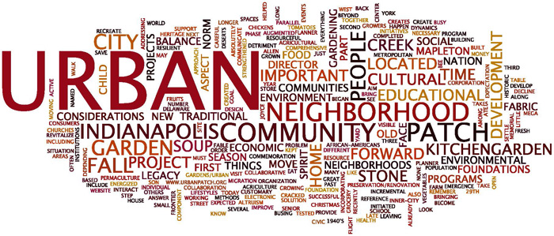
Our mission is to make the American inner city better.
Notes:
Who We Are

Slide 4
The Goal
What do we do now and how do we plan for a sustainable long-term solution?
Multi-tasking teams
Incremental progress
Immediate - OASI$
Mid term _____________________?
Long term _____________________?
Sustainability based on changing population

Slide 5
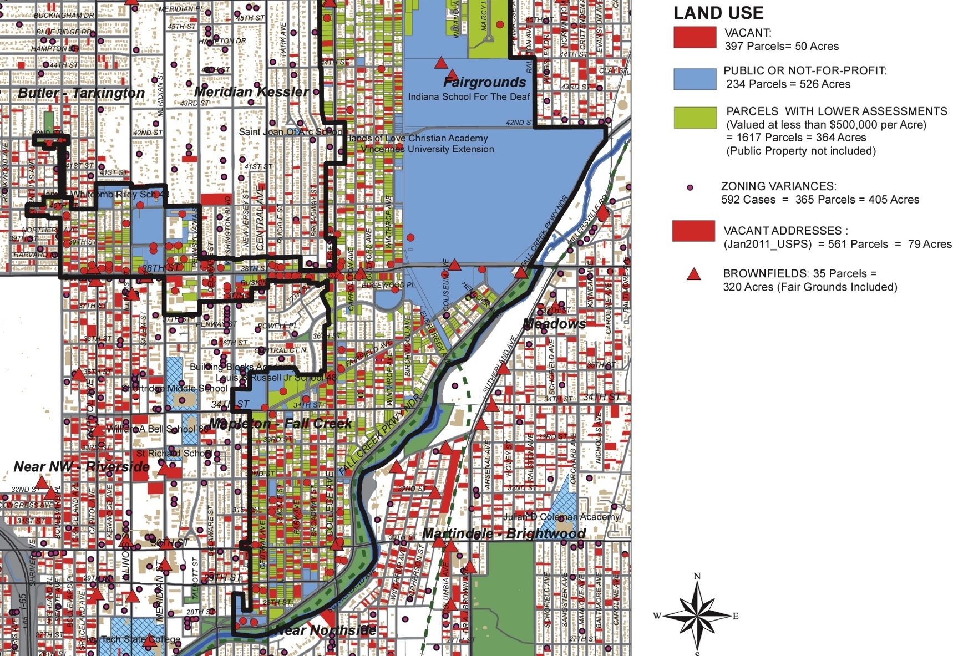
Mid-North current development patterns and vacancy

Slide 6
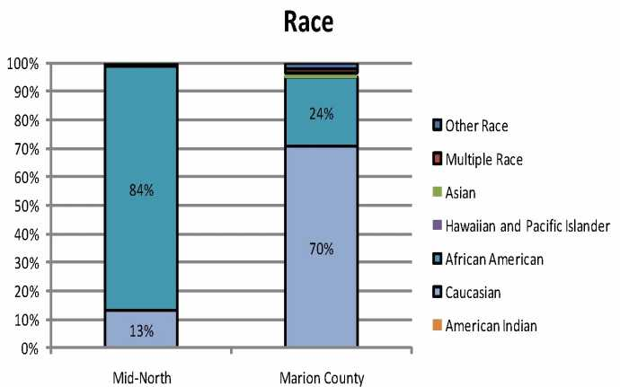
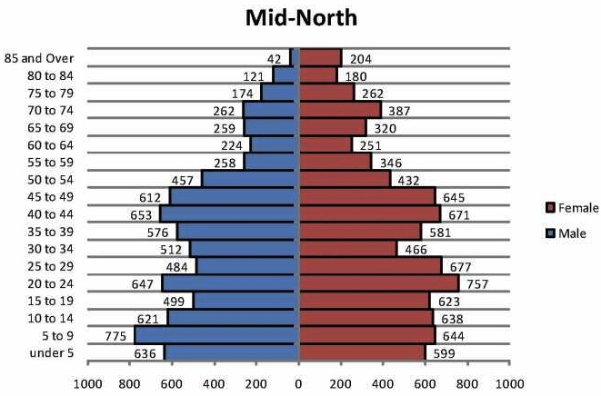
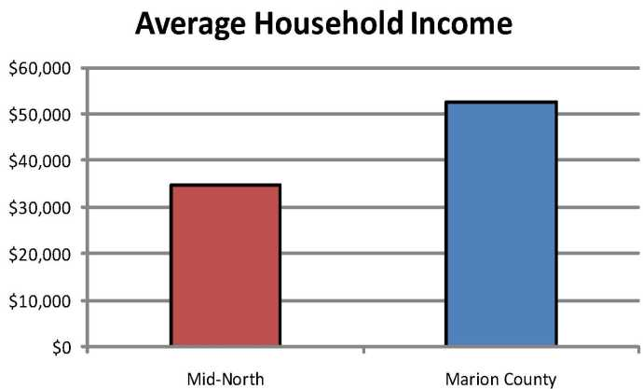
Mid-North demographics
RACE
Mid-North has 5,170 people per square mile
(2X the Indianapolis average density)
Mid-North has 10,900 people, 85% Black
Large youth population (under 9 years old)
Household incomes are ~ $34K/year
(35% below the Indianapolis average)
AGE
INCOME

Slide 7
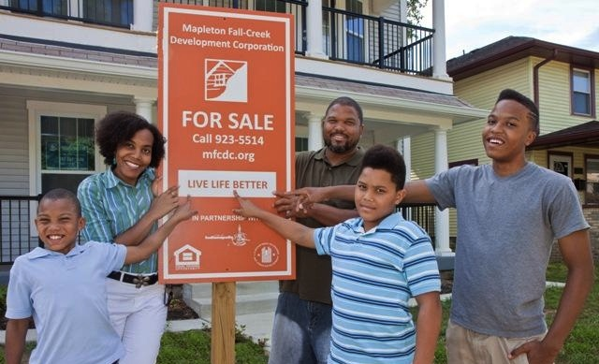
Mapleton-Fall Creek development plans
MFCDC (local development corporation) food access is part of QOL Plan

Slide 8
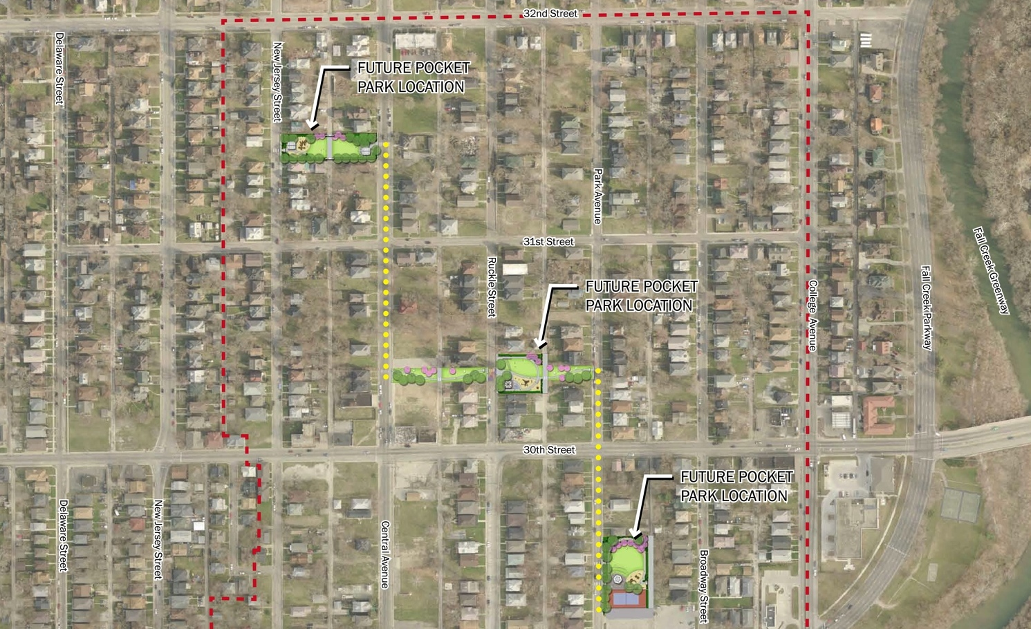
Our model is designed to augment these existing efforts
3. brief summary of positive things going on (community partners, renewal of the city, but also challenges of potential gentrification
Smaller-scale approach with building/open space/community programs
Urban Patch interventions

Slide 9
Urban Patch “dynamic” community development model
3. brief summary of positive things going on (community partners, renewal of the city, but also challenges of potential gentrification
Individual project goals are flexible, based on timing, funding, availability, etc.

Slide 10
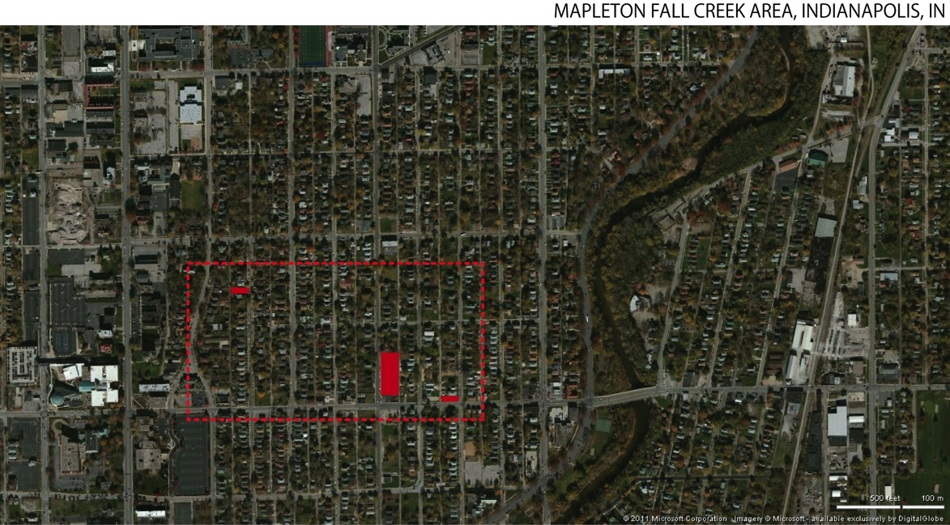
Phase 1: a geographically-targeted approach
Generally located along the 30th Street Corridor with nearby existing community assets (schools, museums, etc.)

Slide 11
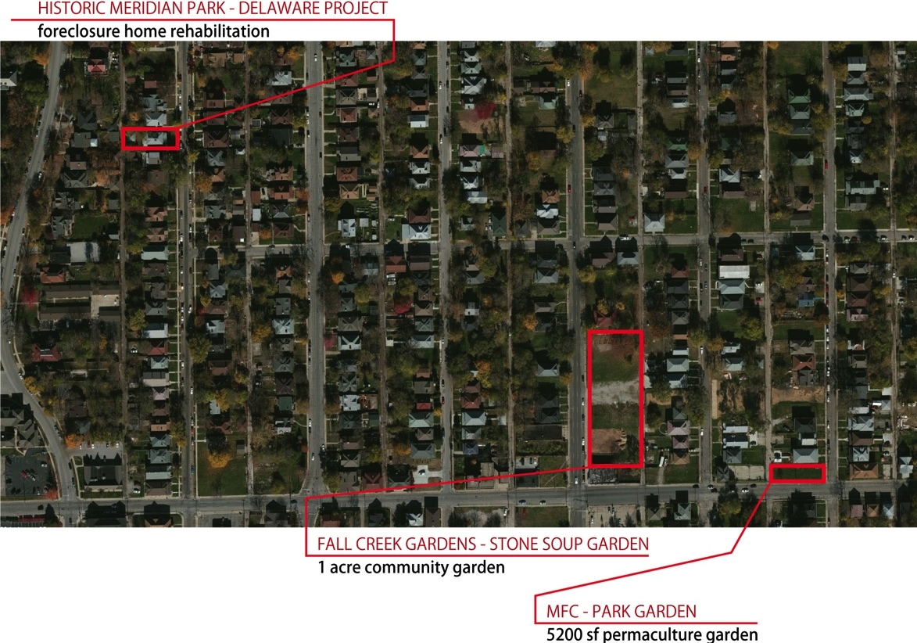
Phase 1: projects are within walking distance

Slide 13
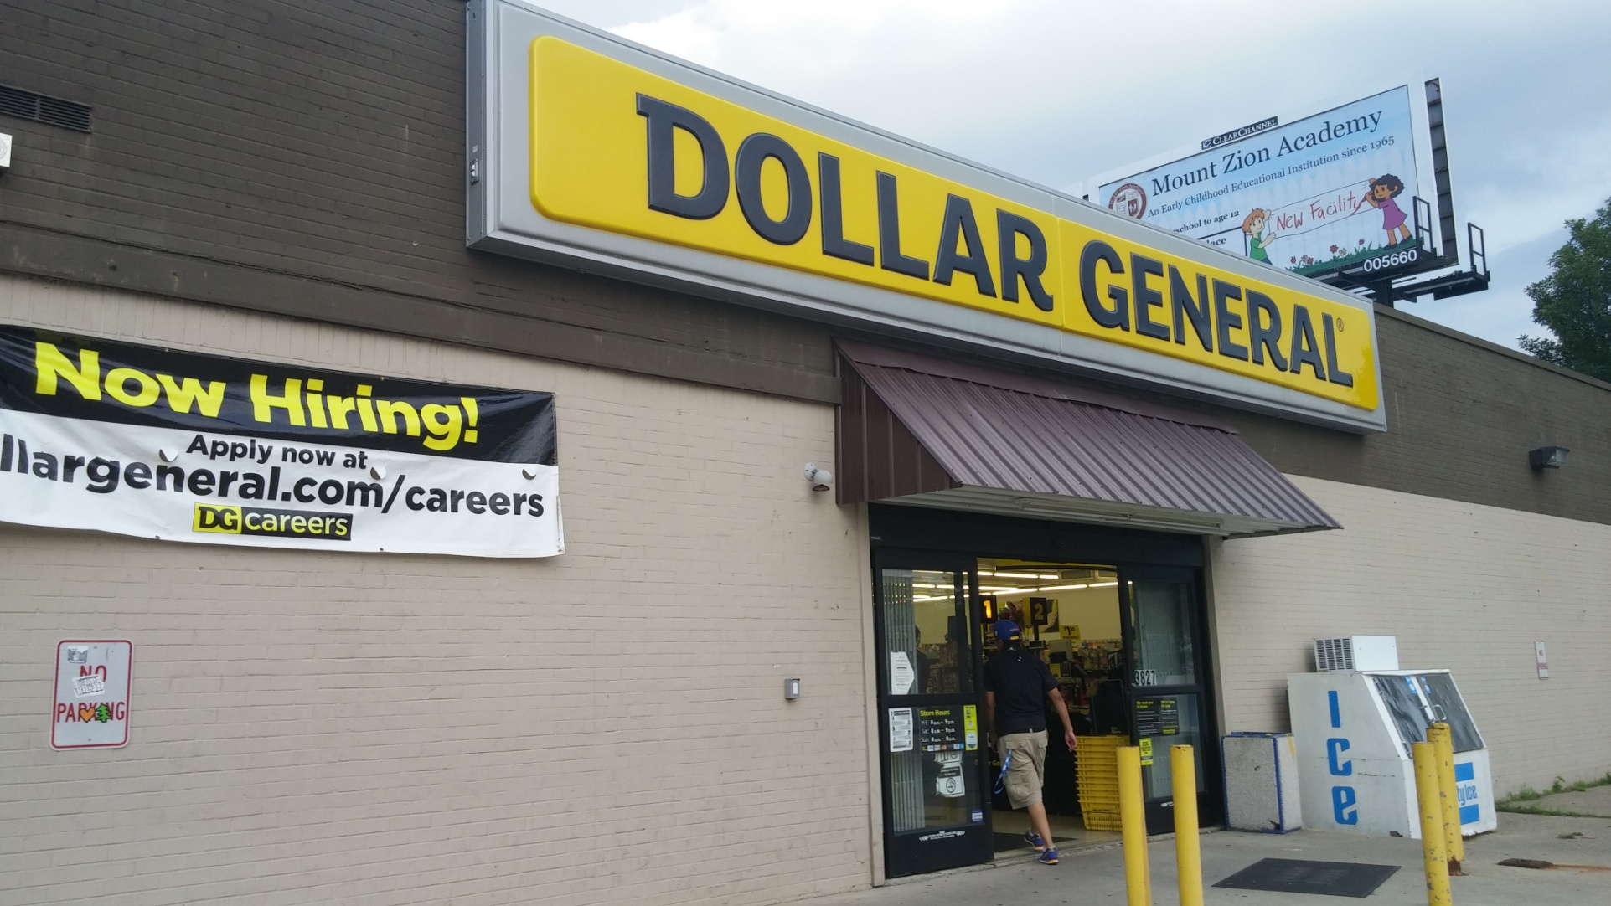
Accessible and in place

Slide 14
Dairy and Eggs

Slide 15
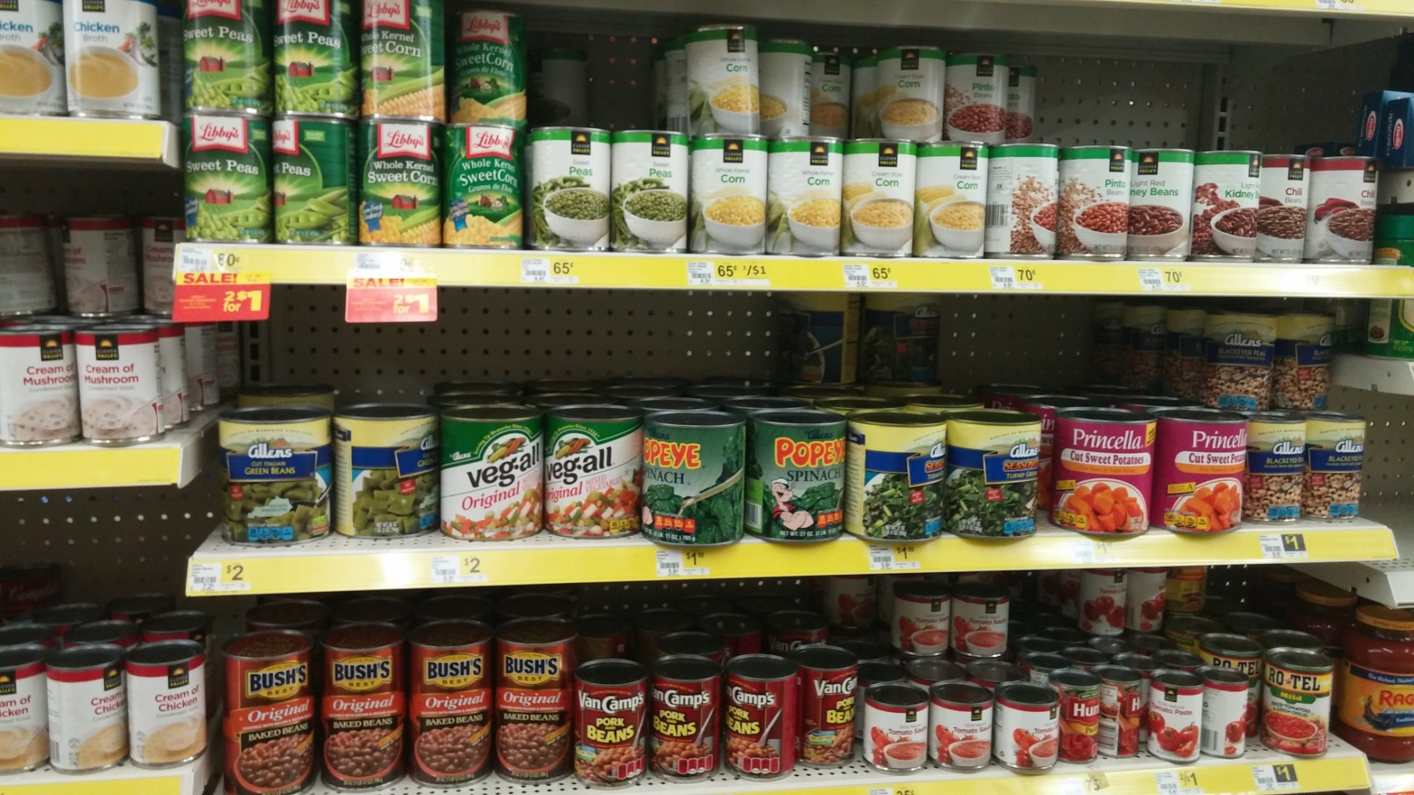
Good Food

Slide 16
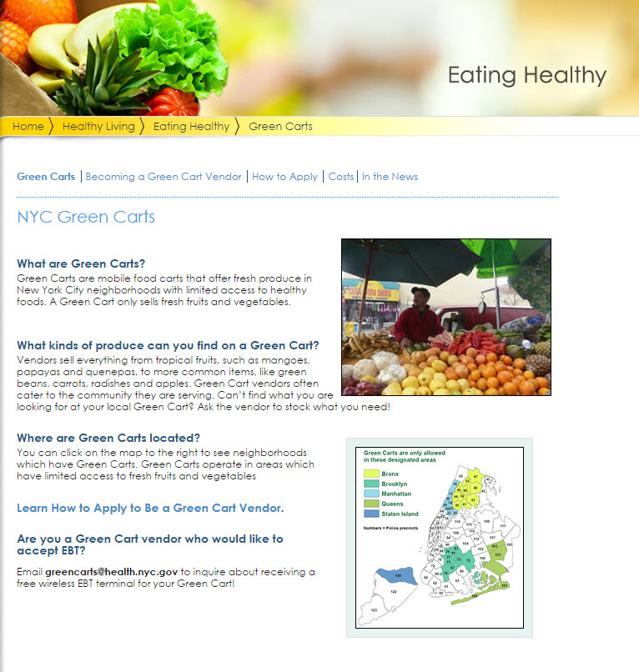

Slide 17
How do we start?
Market study: information we need to make a sustainable 'oasis' in the neighborhood and maybe in the process we can also -
Bring back jobs
Bring back engagement of residents
Encourage business ownership

Slide 18
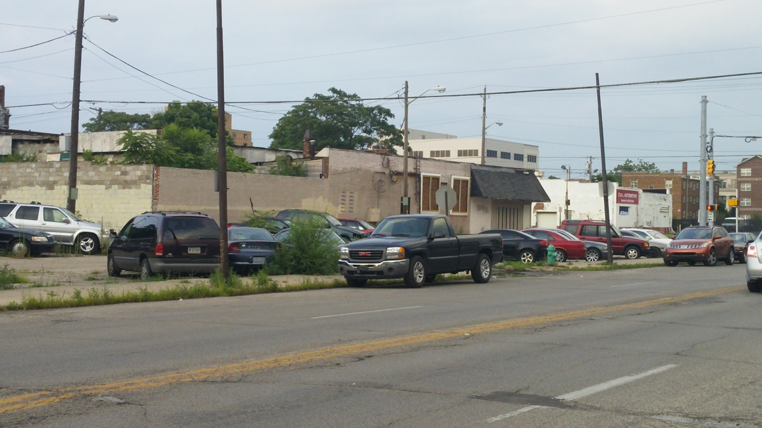
I. Market study: information we need to make a sustainable 'oasis' in the neighborhood
The CDC has done mapping, population and location studies and projections, etc.
We need to get engaged so we have say of what is already in place and work to help make happen.

Slide 19
II Some Options and Examples
Pogue’s Run Grocery – Co-Op:
Bed-Stuy Fresh: http://www.bedstuyfreshandlocal.net/
Shop-Rite:
http://www.nj.com/camden/index.ssf/2014/10/camden_pricerite_first_grocery_store_to_open_in_the_city_in_decades.html
Sterling Farms: http://archive.thetowntalk.com/article/20140506/NEWS01/140506002/Sterling-Farms-close-flagship-store-Marrero-plans-open-stores-Alexandria-Atlanta
NYC Green Cart: http://www.nyc.gov/html/doh/html/living/greencarts.shtml

Slide 20
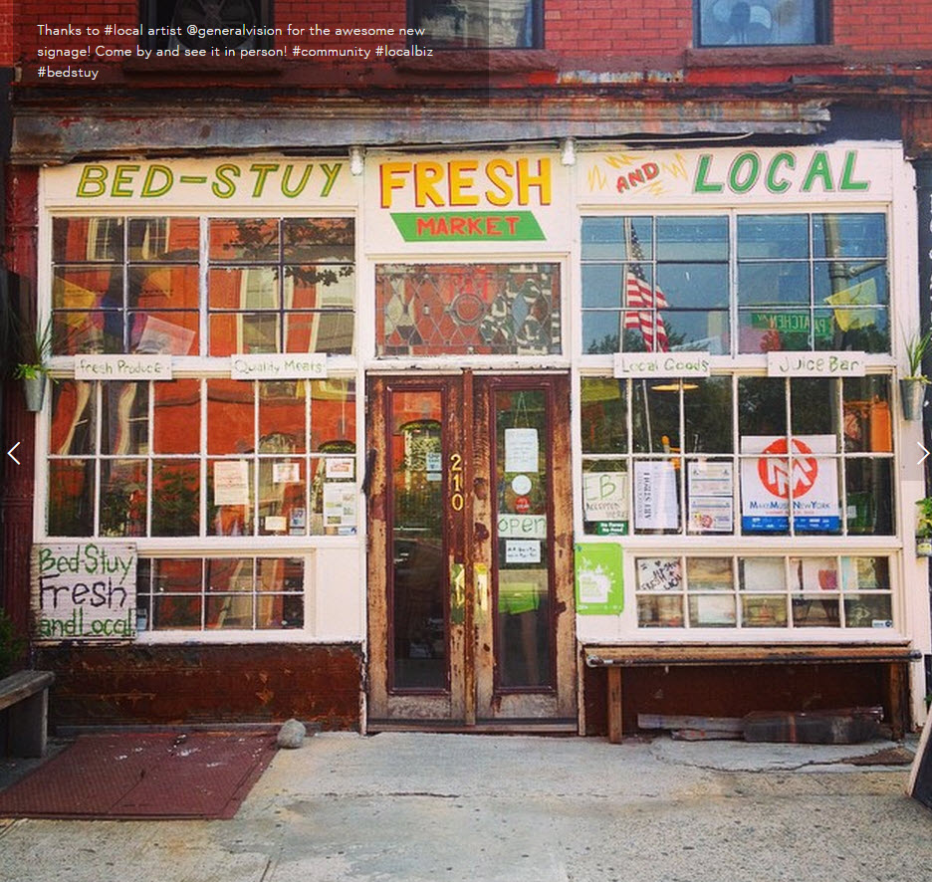
Bed-Stuy Fresh Local: http://www.bedstuyfreshandlocal.net/

Slide 21
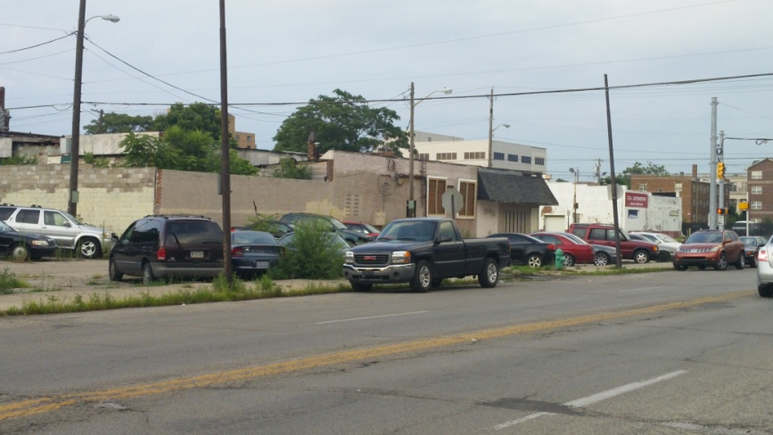
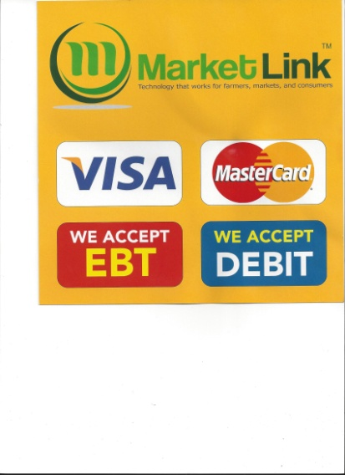
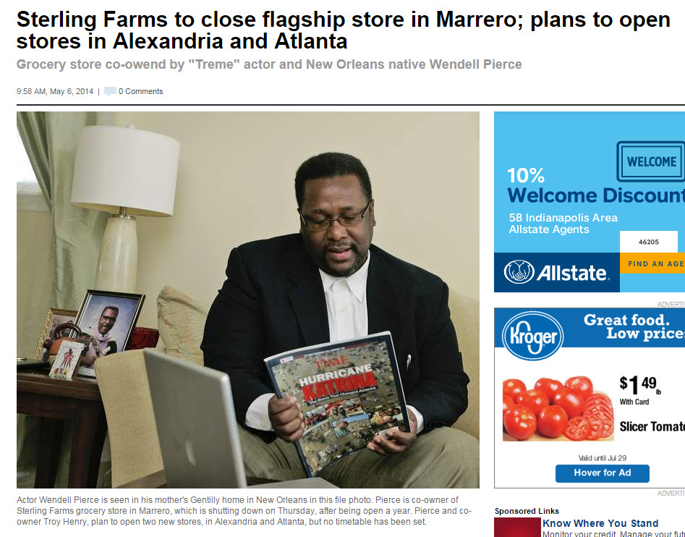
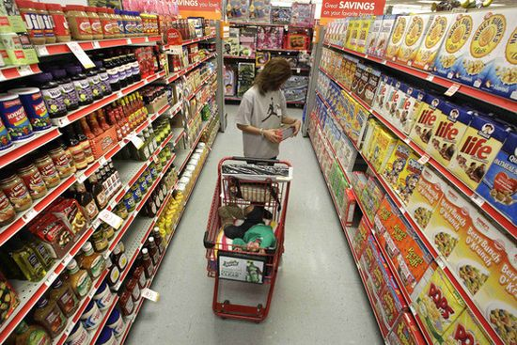
Sterling Farms
Shop-Rite
Shop-Rite
Sav-a-Lot
Aldi,
IGA
?

Slide 22
III. What do we do now and how do we plan for a sustainable long-term solution.
Green Carts
Bodegas
Other Development Sites
CDC site Central and Fall Creek?,
Fairgrounds Fairfield and Monon Site?
Existing Double 8 site?
More Regular Farmers Markets?
Get an affordable grocery store (independent grocer?) to locate in the neighborhood?
Shop-Rite, Sav-a-Lot, Aldi, IGA

Slide 23
IV. Next steps - and comments -- Form a neighborhood Food Access Advisory Group?
CDC, City economic development (tax incentives, etc.?), neighborhood associations, Indy Food City Council, State Officials, IN Fairgrounds, Purdue Extension
Outreach to grocery store chains, real estate developers who do retail projects, what is already in the works, etc.
SWOT analysis, market study, case studies necessary research for what to do next.

Slide 24
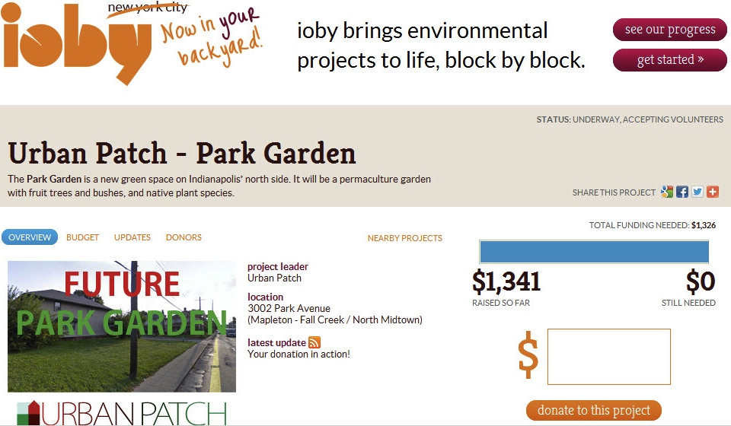
Park Garden
Social media campaign raised over $1300 in 3 weeks using ioby.org

Slide 25
Tonight’s Agenda
Advisory Food Access Team - Pass Around Team Sign-Up Sheets
Create a grassroots team model that can be easily duplicated in other impacted neighborhoods
Small selection committee to be formed to get started and coordinate efforts in the MFC community.
Other communities are welcomed to attend and participate so they may glean from our efforts for their communities as well.
Input from Community / Neighborhood Stakeholders (25 minutes)
Final Comments and Remarks (8 minutes)

Slide 26
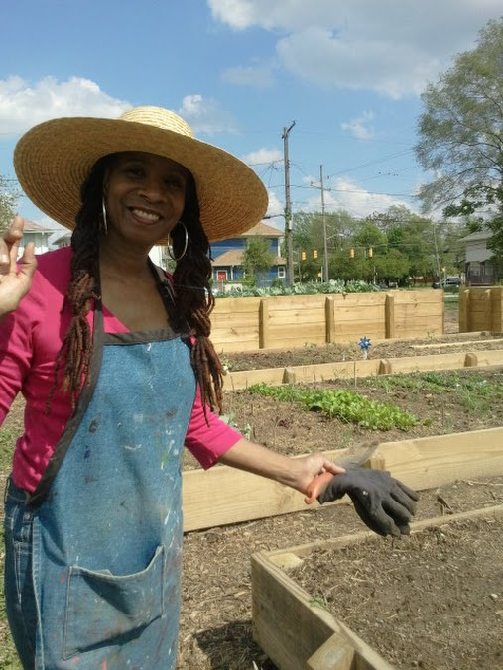
Questions?
Visit us at:
urbanpatch.org
mfcdc.sharepoint.com/Pages/default.aspx
fallcreekgardens.org

